Slide 1
Scaling the EC2 Instance Based on Monitored CloudWatch Metrics Course - AWS Developer Associate
By – Nilesh Shardul
Email – Nileshbshardul@gmail.com

Slide 2
DESCRIPTION
Let’s take the case of Hotstar — a platform that provides on-demand video streaming services. The more the users join the streaming service platform, the more the resources in terms of servers (EC2 in AWS) Hotstar needs to invest in. This way, the load is distributed across different servers and leads to jitter-free experience for the customers while watching the videos. Another example is Amazon Prime Day, where a bevy of customers access the amazon.com site. Depending on the number of customers logging into the amazon.com site, Amazon would like to add more servers for better customer experience.
Both the above actions lead to increased customer satisfaction, which will eventually boost profits for the companies. This feature of adding and removing servers is called Dynamic Scaling and is a unique feature of the Cloud. Simply put, the users of the Cloud can scale to thousands of servers and scale down when appropriate and pay for what they use. However, that flexibility to add/subtract servers does not come with the on-premise servers, which is why the cost is always fixed. Also, during the slack time, many resources remain under- utilized which is a wastage of CAPEX. One way of adding and deleting the EC2 instances is to do it manually which may lead to extra manual effort, increase in costs, and inaccurate results.
Another approach is to use Auto Scaling to manage the EC2 instances automatically. As Auto Scaling adds more EC2 instances, the software/application installation and configuration can be automated using the AMI (Amazon Machine Images). In the previous use case, we have seen how to capture custom metrics (number of users logged in) in the CloudWatch. Here, we would need the same metric to manage (add/delete) the EC2 instances depending on the number of users logged into the website.
Tools required: AWS Services - CloudWatch, Auto Scaling, EC2
Expected Deliverables:
Use Auto Scaling to manage the EC2 instances
Use EC2 instance and capture the metrics in the CloudWatch

Slide 3
MAJOR STEPS
Create IAM Role for the EC2 instance to publish data in CloudWatch
Create EC2 instance and install required software
Create Custom Metric and verify data can be published to CloudWatch from EC2
Create an Image of the EC2 instance(AMI)
Create Launch Template
Create Auto-Scaling Group
Create CloudWatch Alarm and test Auto-Scaling

Slide 4
Create IAM Role for the EC2 instance to publish data in CloudWatch
Note: All configuration selected as per free tier available

Slide 5
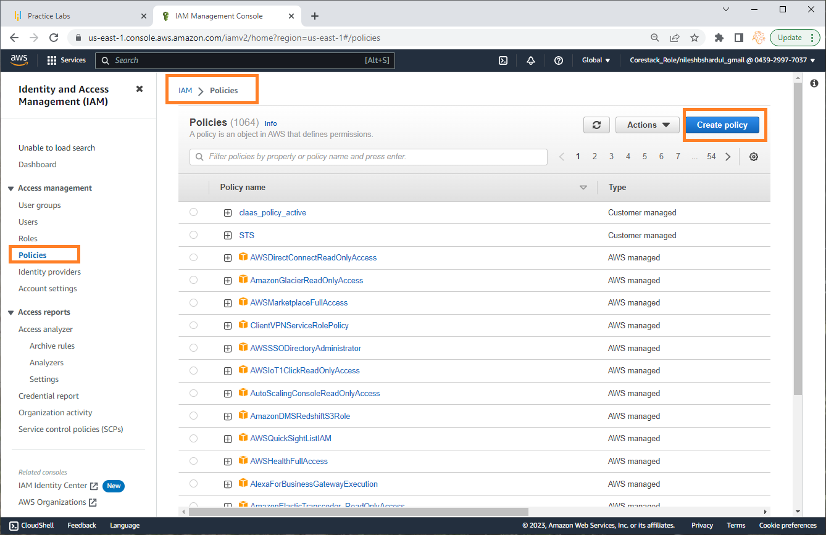
Step 1: Go to IAM and then policies from the left menu. Click on Create Policy

Slide 6
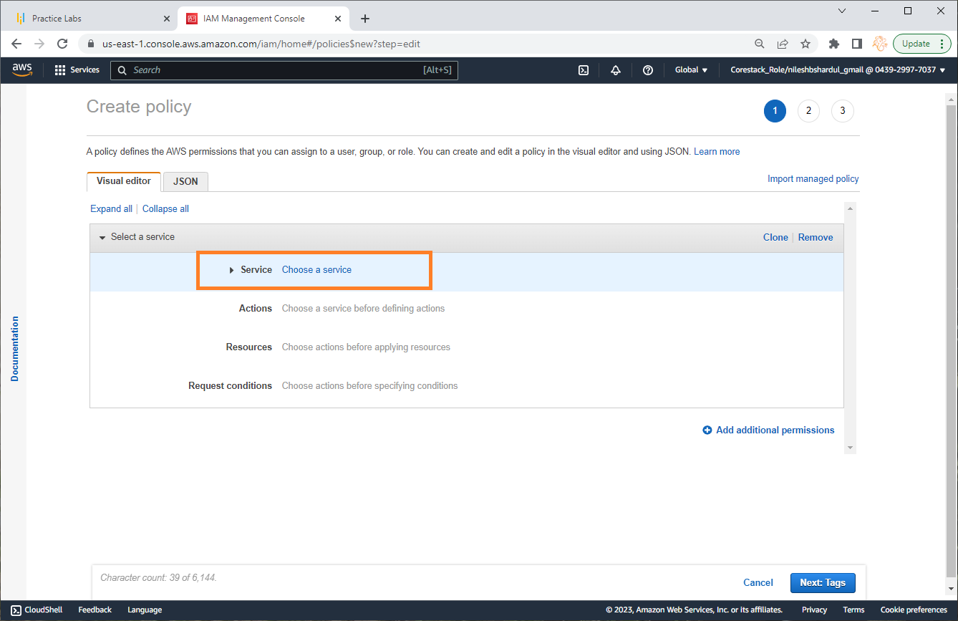
Step 2: Click on Choose a service option

Slide 7
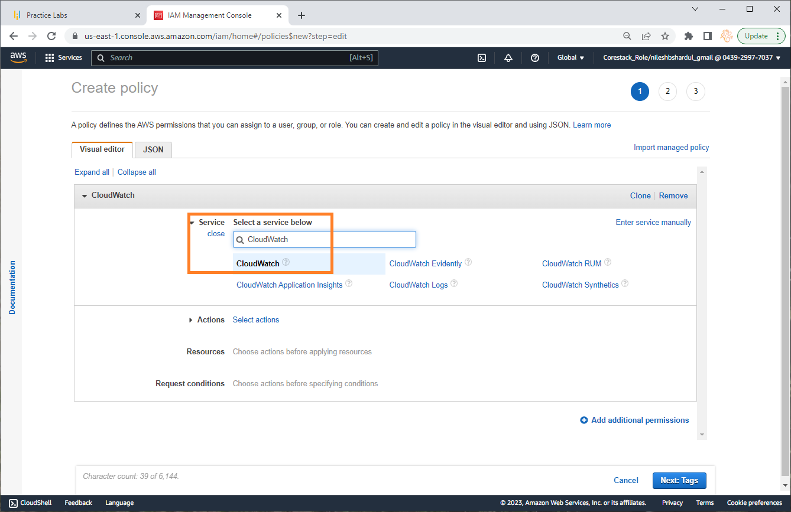
Step 3: Search for CouldWatch service and select the same

Slide 8
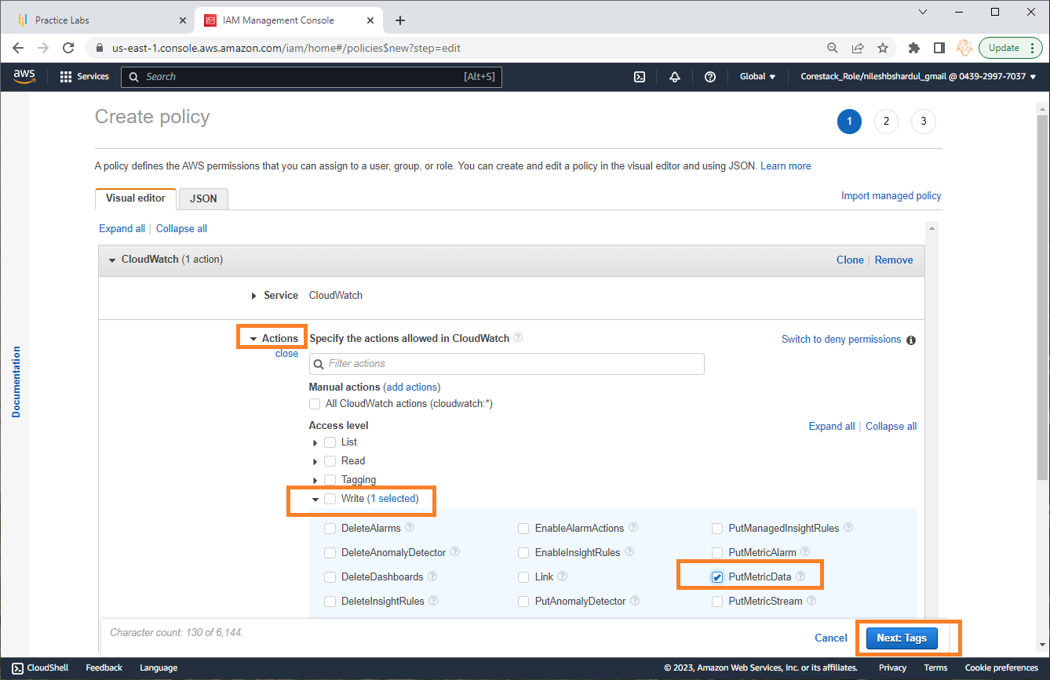
Step 4: In Actions click on Write in Access level and select PutMetricData checkbox as shown below. Click on Next: tags button below

Slide 9
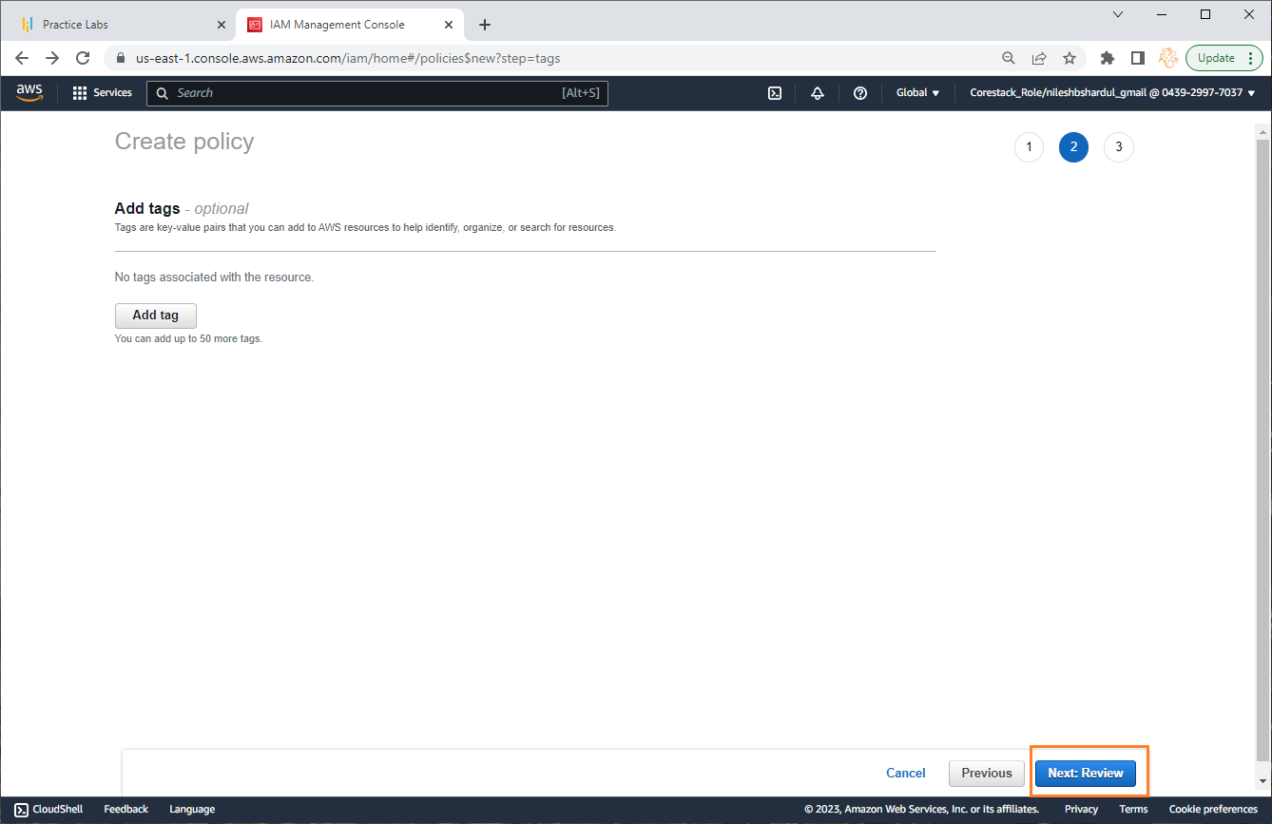
Step 5: Click on Review button (Note : You can add some tags here if required for the application)

Slide 10
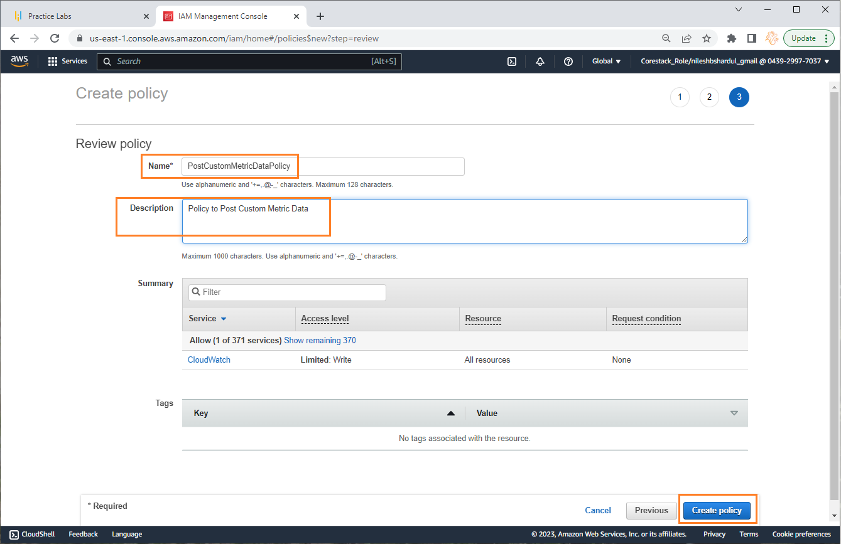
Step 6: Give policy name e.g. PostCustomMetricDataPolicy and add some description. Click on Create Policy button below

Slide 11
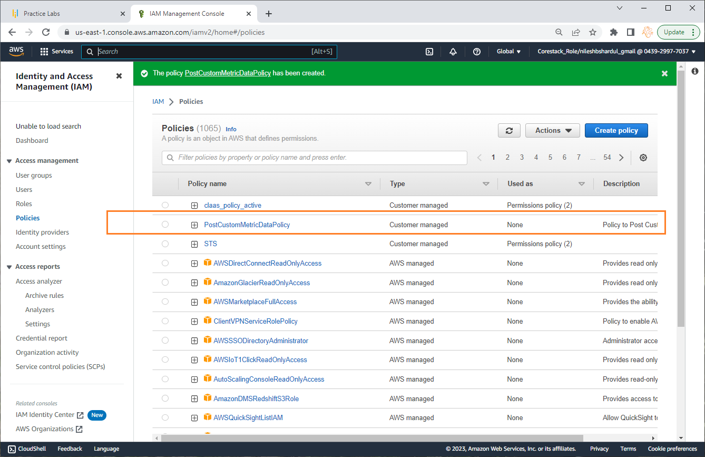
Step 7: Check the new policy has been created as shown below

Slide 12
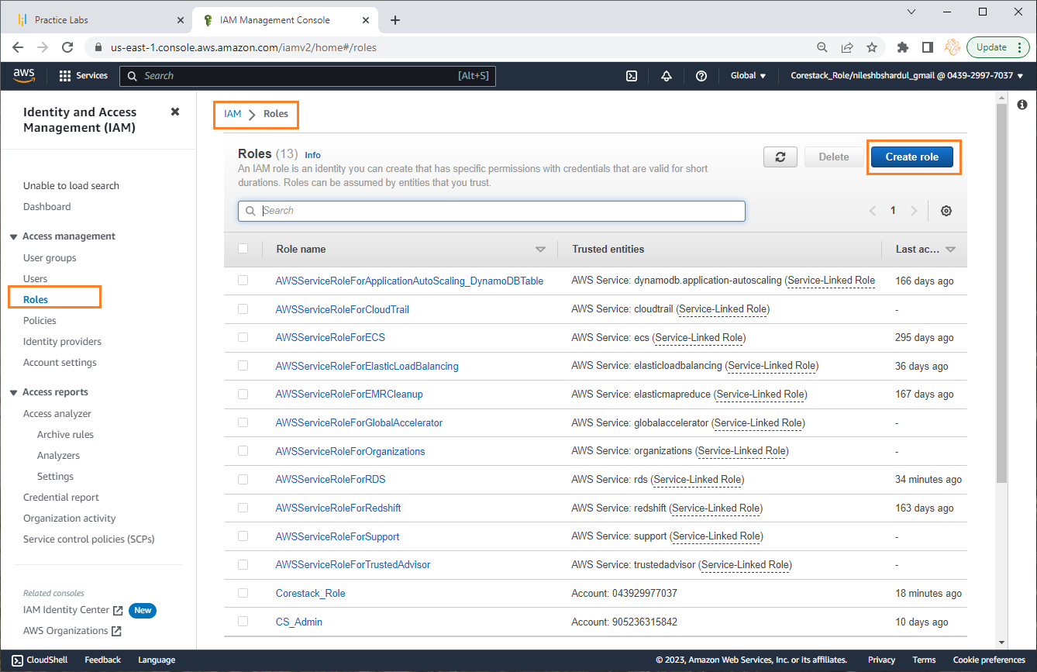
Step 8: Now click on Roles from the left menu and then click on Create role button

Slide 13
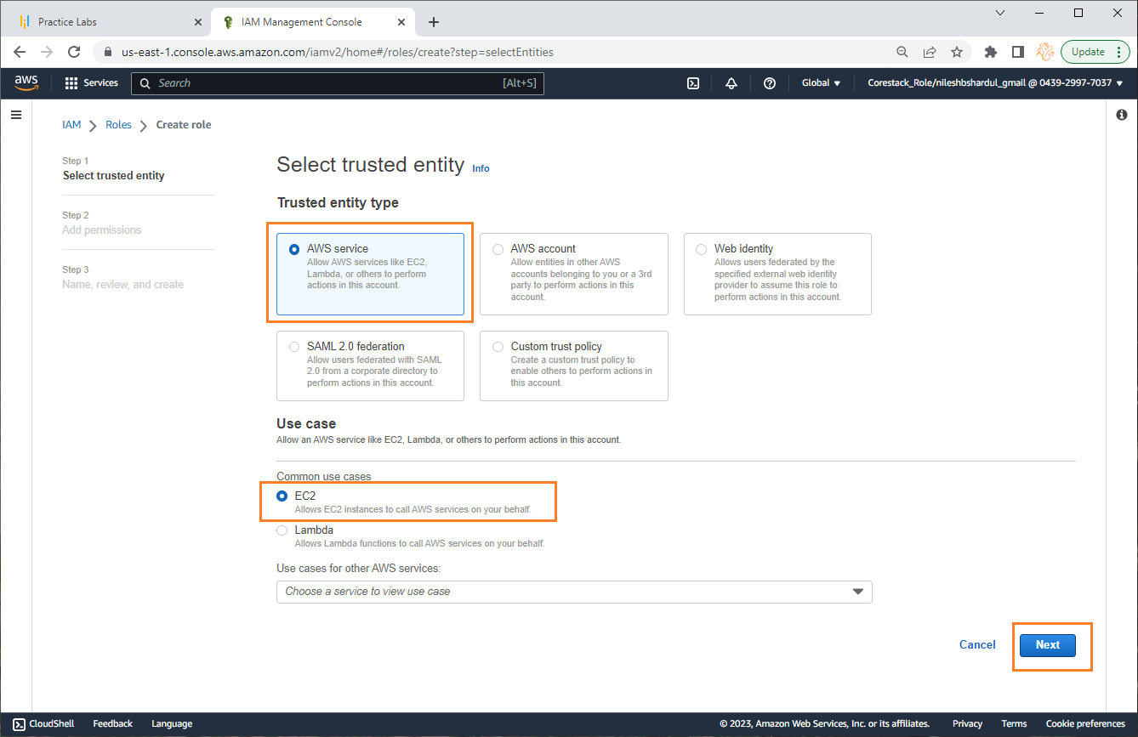
Step 9: Select AWS service in Trusted entity type and EC2 in the Use case to use this role for EC2 instance. Click on Next button below

Slide 14
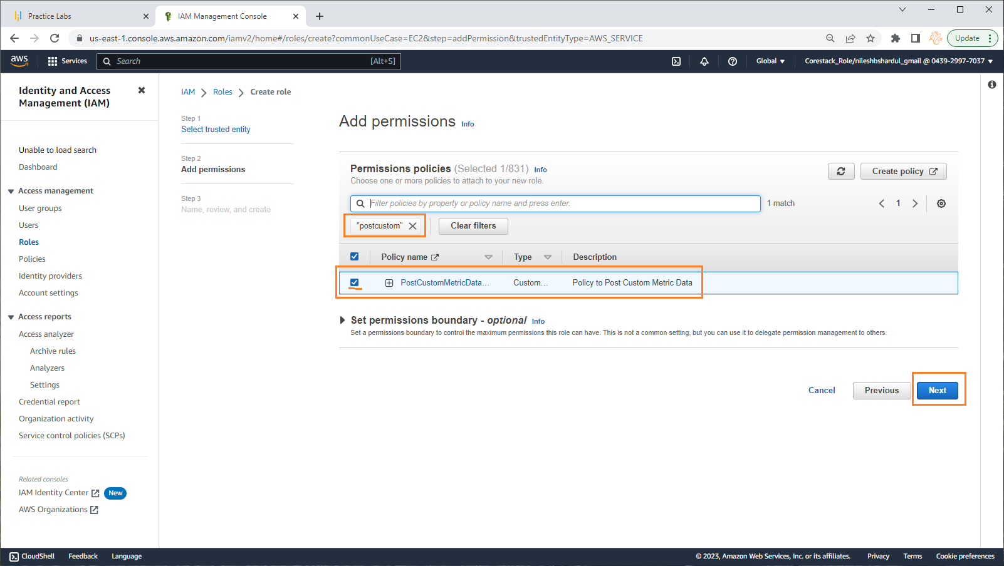
Step 10: Search for the new policy created and select the checkbox once listed below. Click on Next button below.

Slide 15
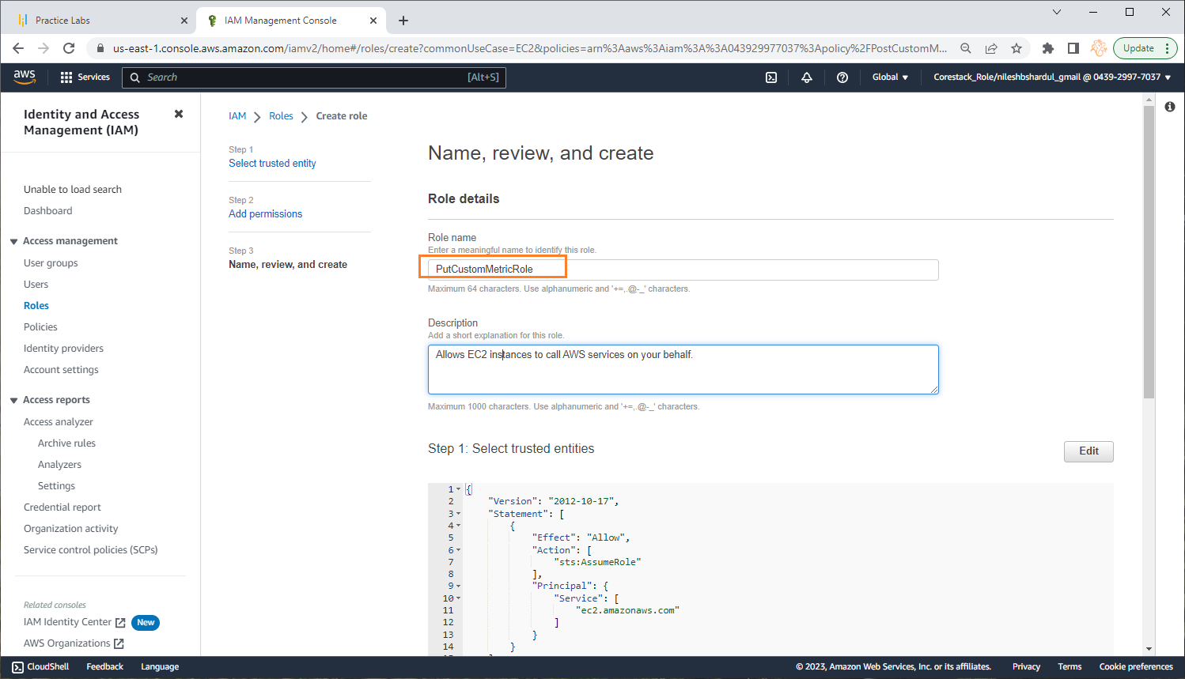
Step 11: Give Role name e.g. PutCustomMetricRole and click on Create role button below

Slide 16
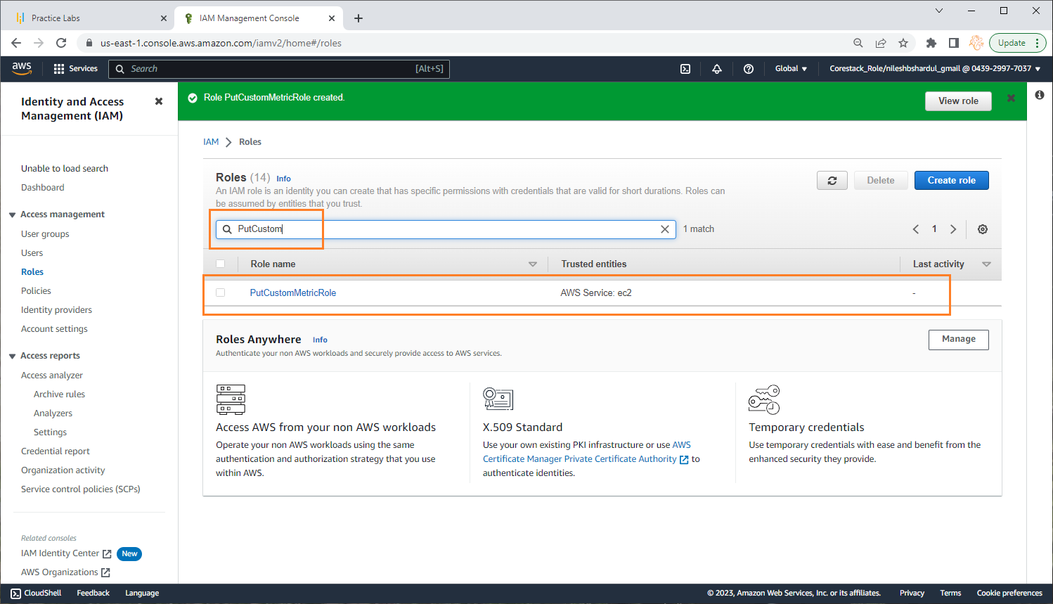
Step 12: Check if you can view the new role in the Roles list searching by name on the top

Slide 17
Create EC2 instance and install required software
Note: All configuration selected as per free tier available

Slide 18
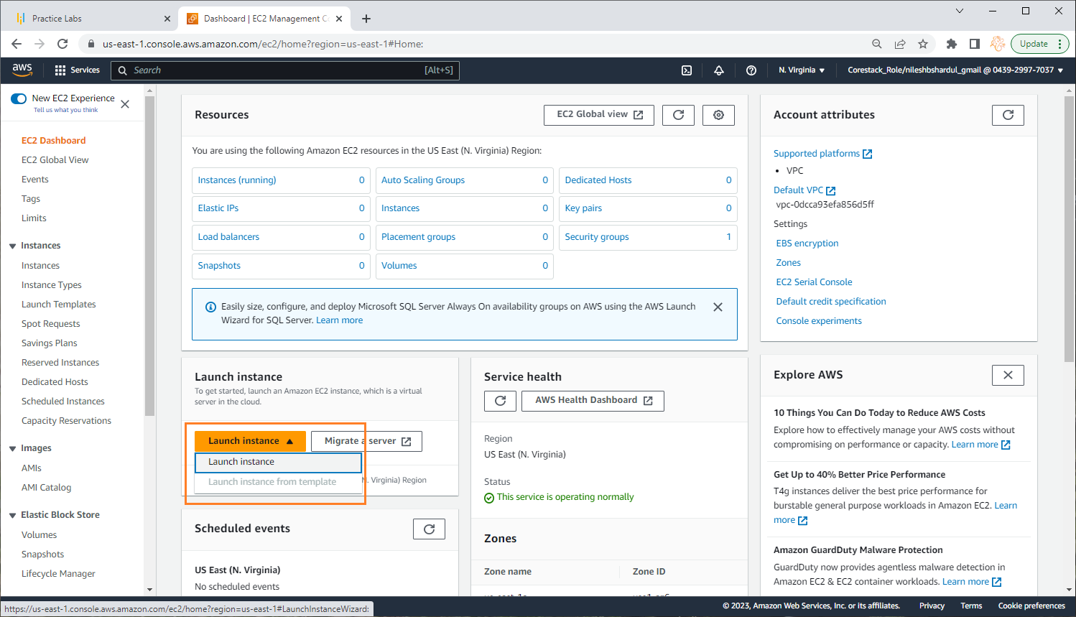
Step 1: Go to EC2 service and click on Lunch Instance

Slide 19
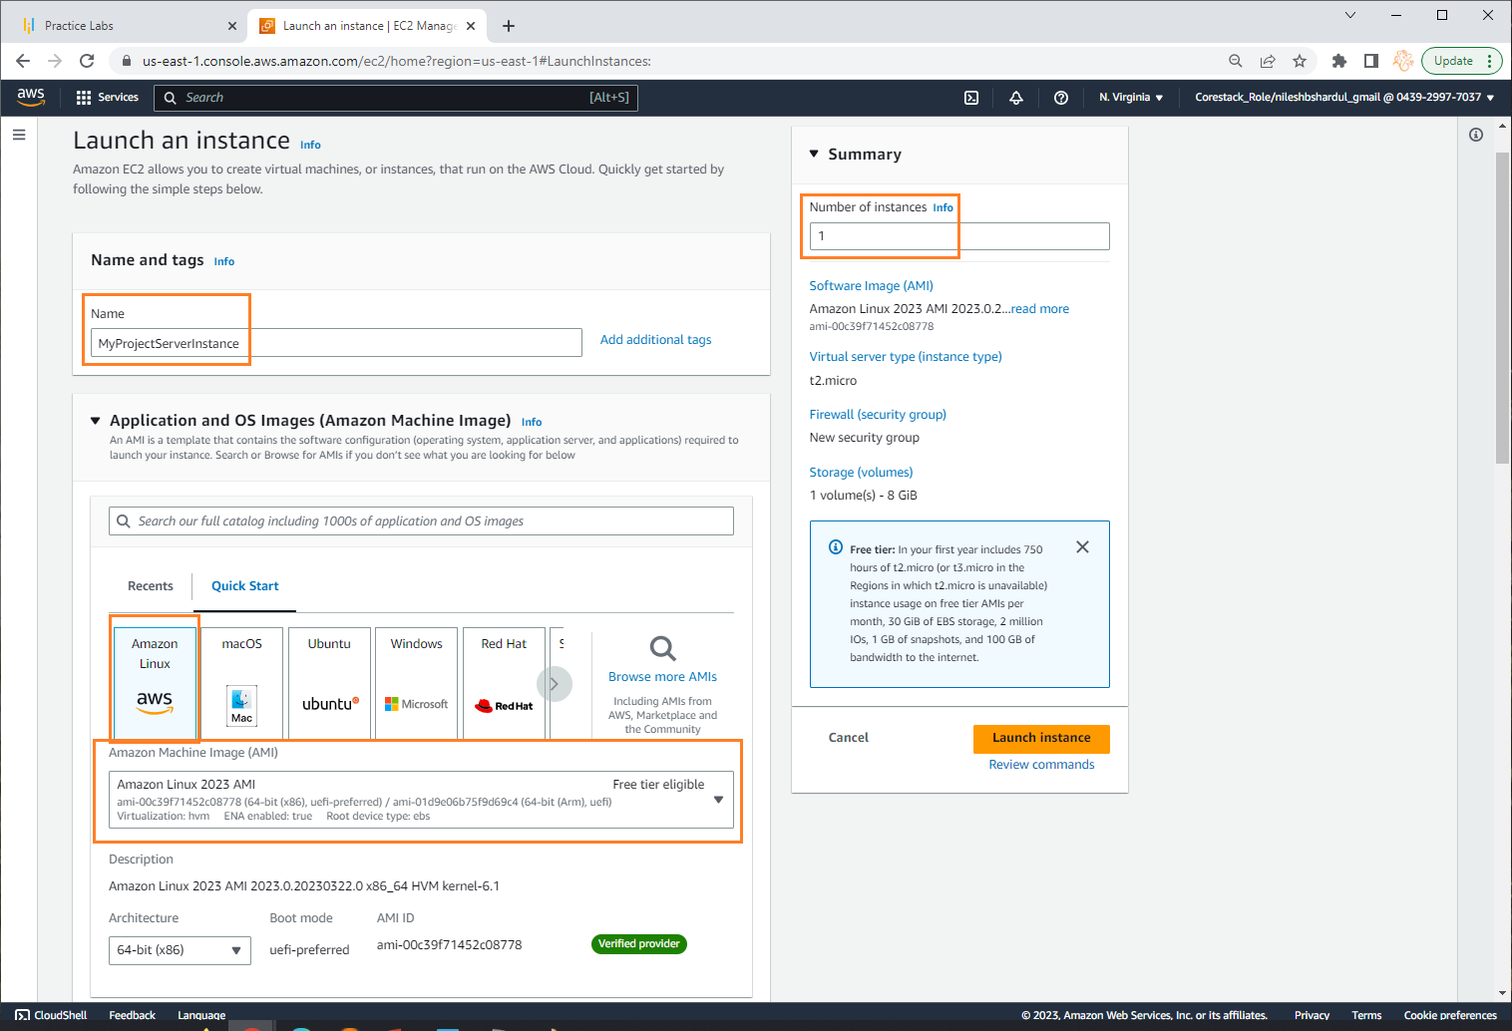
Step 2: Give Instance name e.g. MyProjectServerInstance

Slide 20
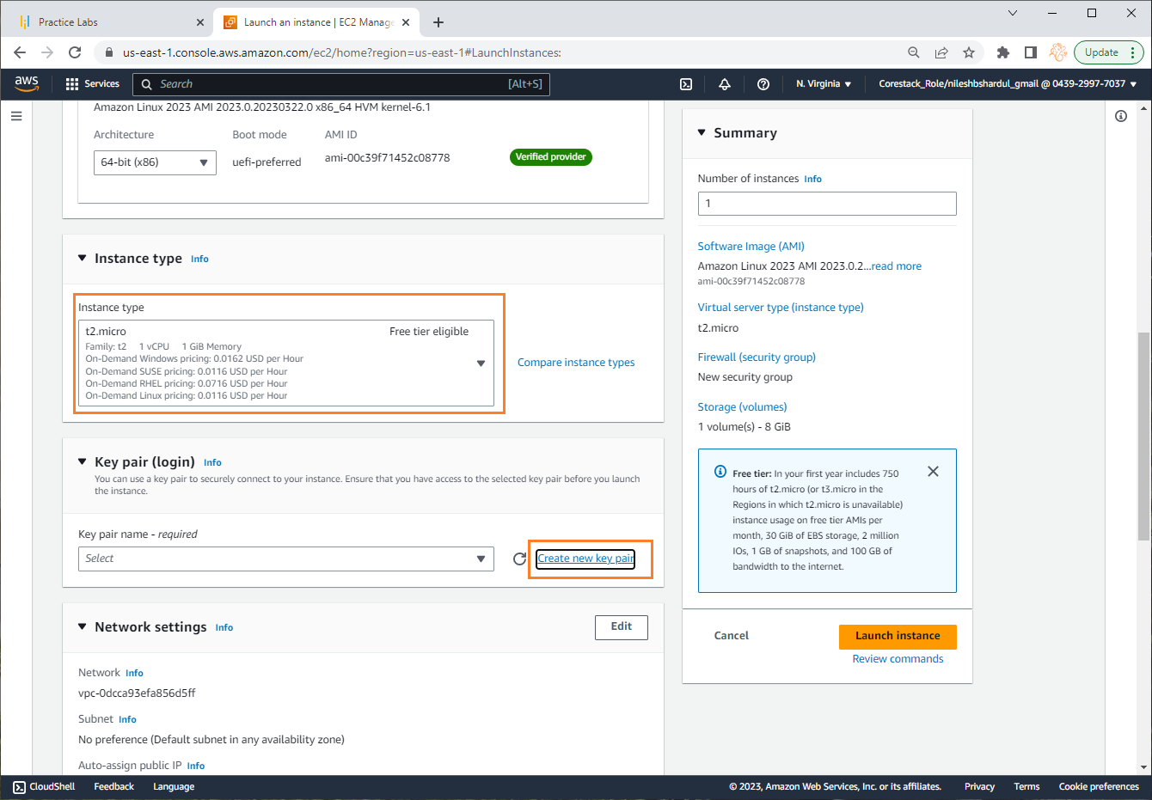
Step 3: Select instance type t2.micro and click on Create new key pair in Key pair(login) section (you can use existing key pair if you have it already)

Slide 21
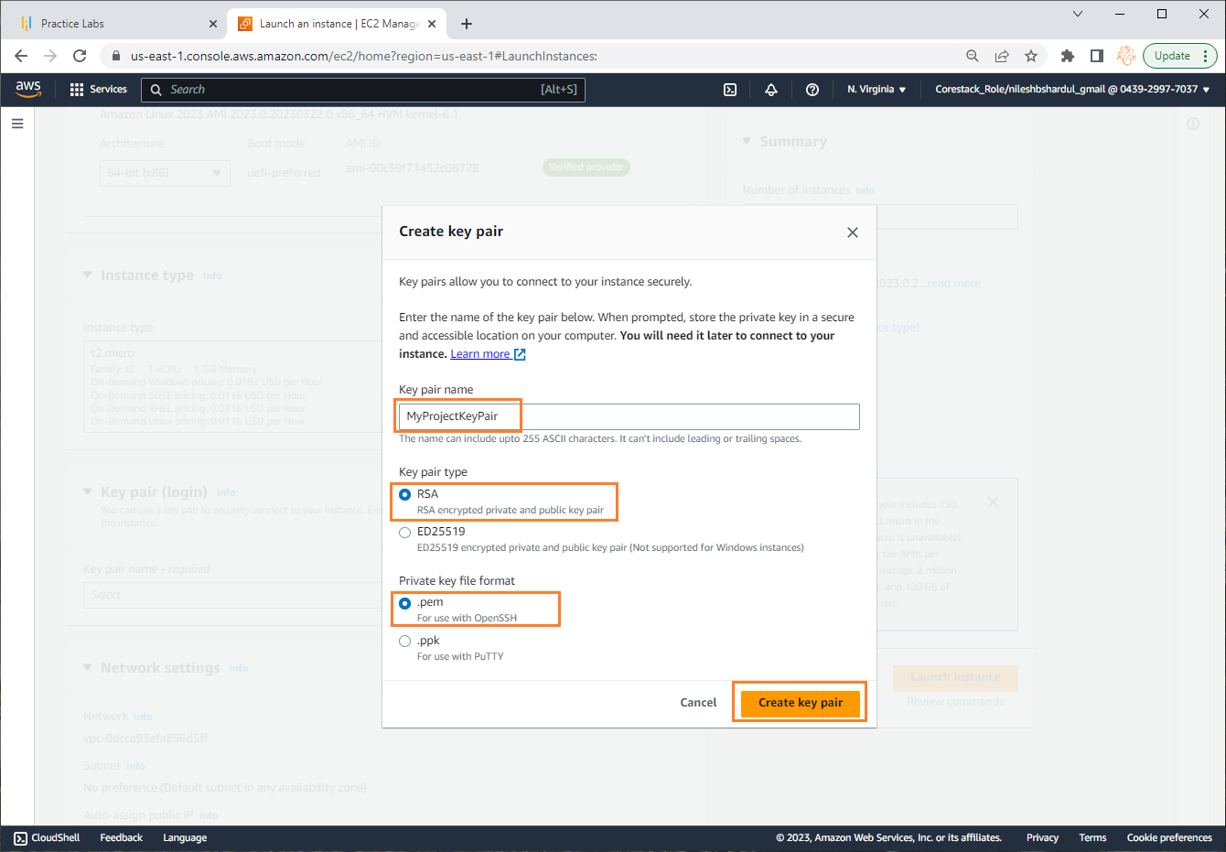
Step 4: Give Key pair name e.g. MyProjectKeyPair and keep default settings below. Click on Create key pair button

Slide 22
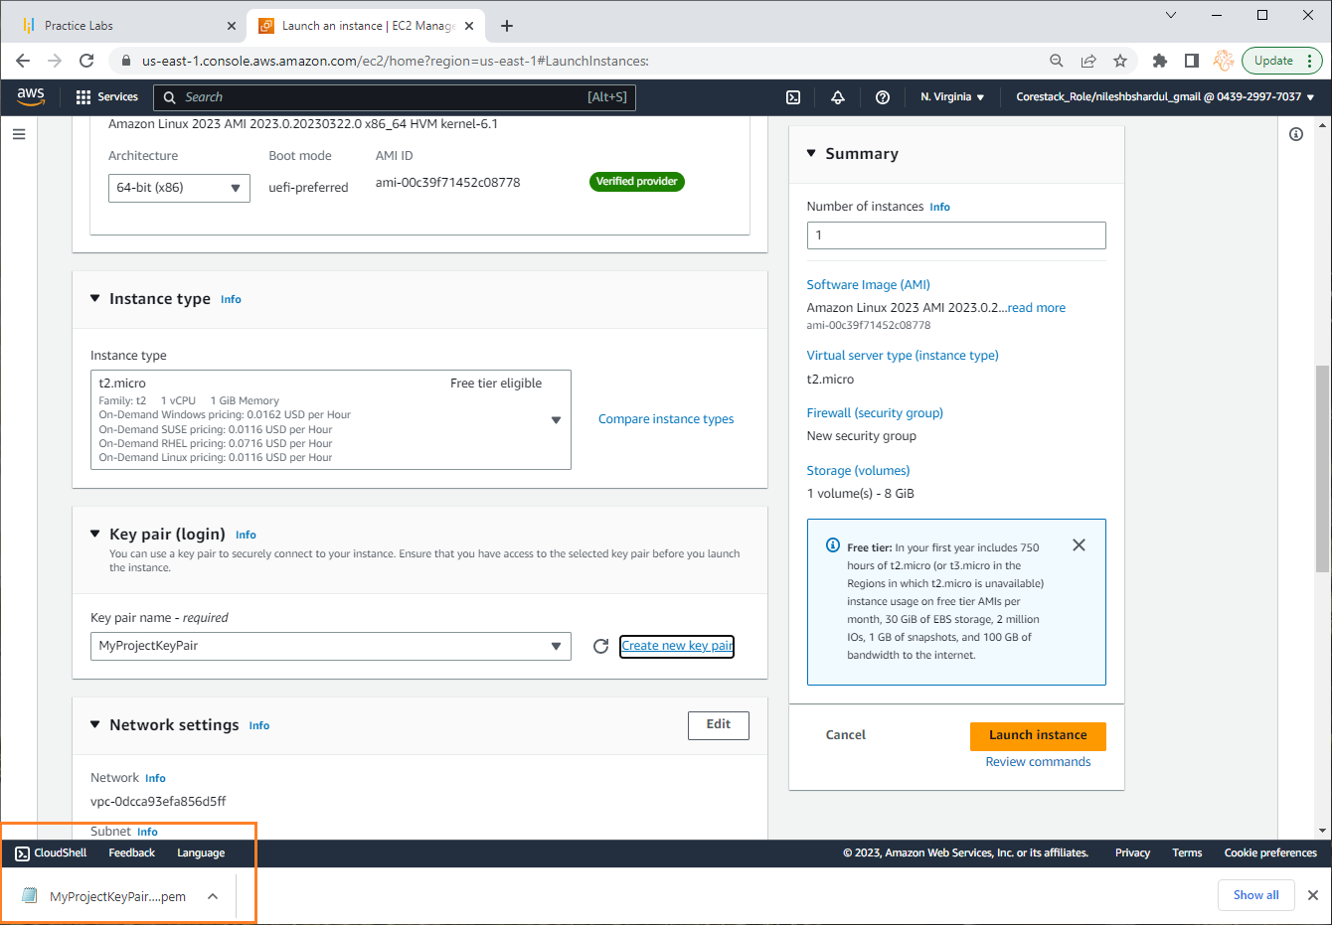
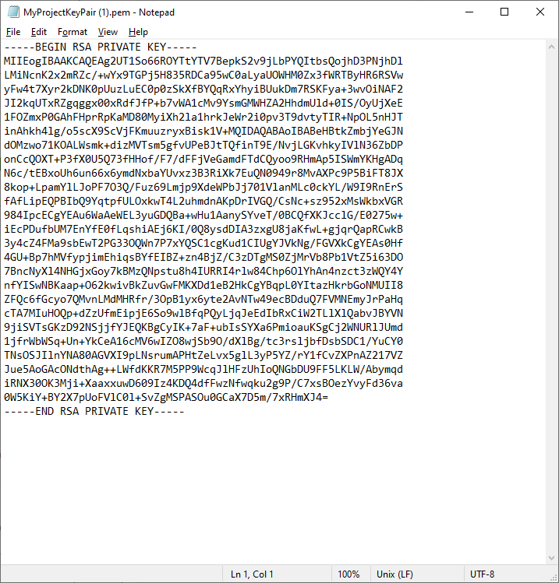
Step 5: Once the key pair is downloaded, open the file using notepad. This is a private key (screenshot shown on the right below)

Slide 23
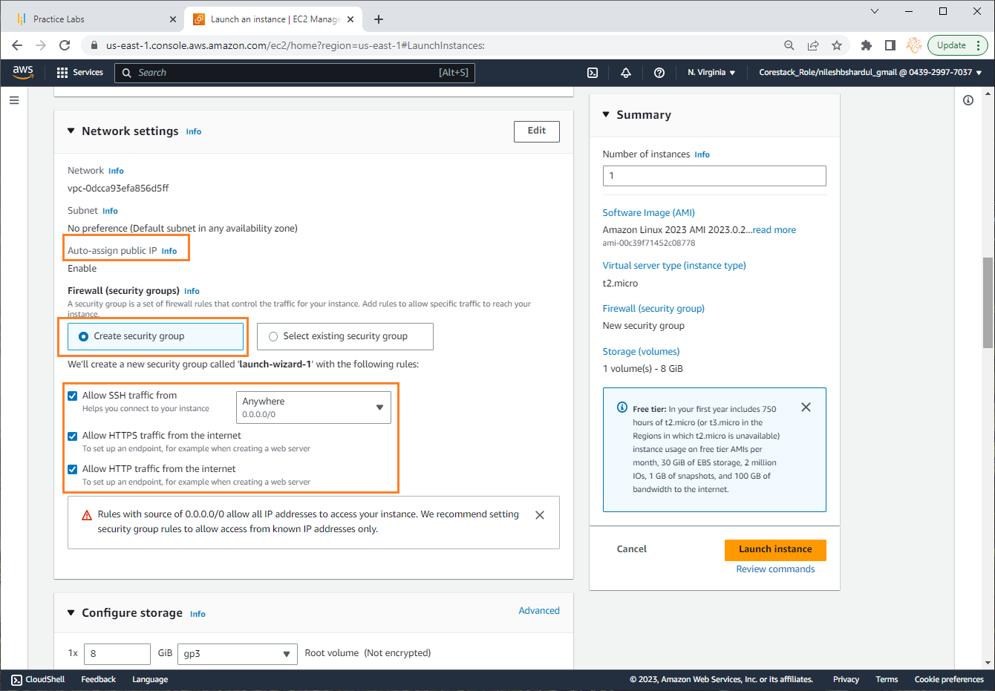
Step 6: Keep some default Network settings (you can select VPC, subnet, Security Group if already created by you), make sure Security group should allow RDP,HTTP, HTTPS traffic as shown in the screenshot.

Slide 24
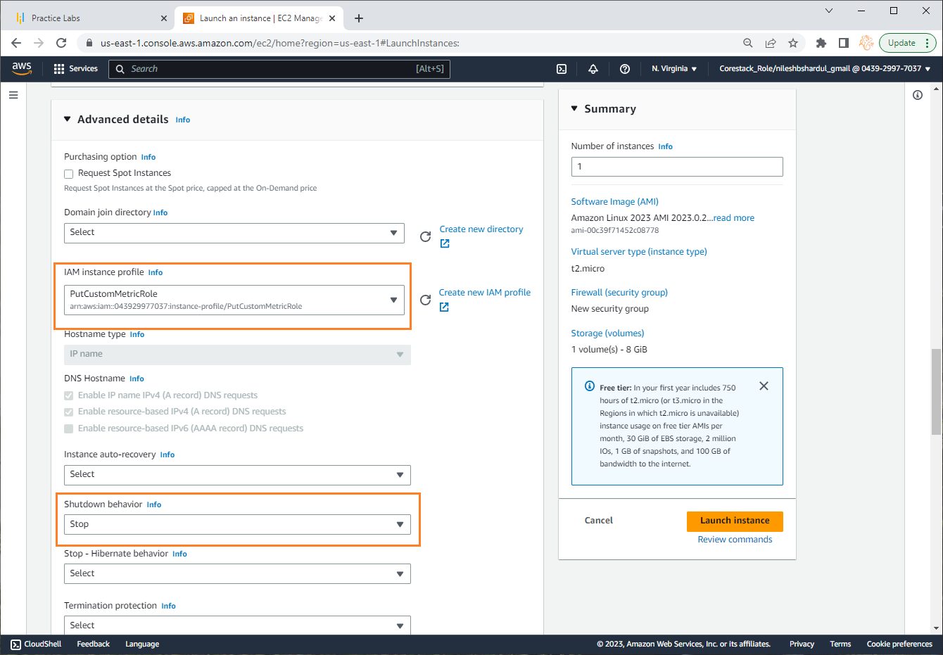
Step 7:In Advanced details select custom role PutCustomMetricRole (created in last steps) in IAM Instance Profile and keep other default settings. Now click on Launch Instance

Slide 25
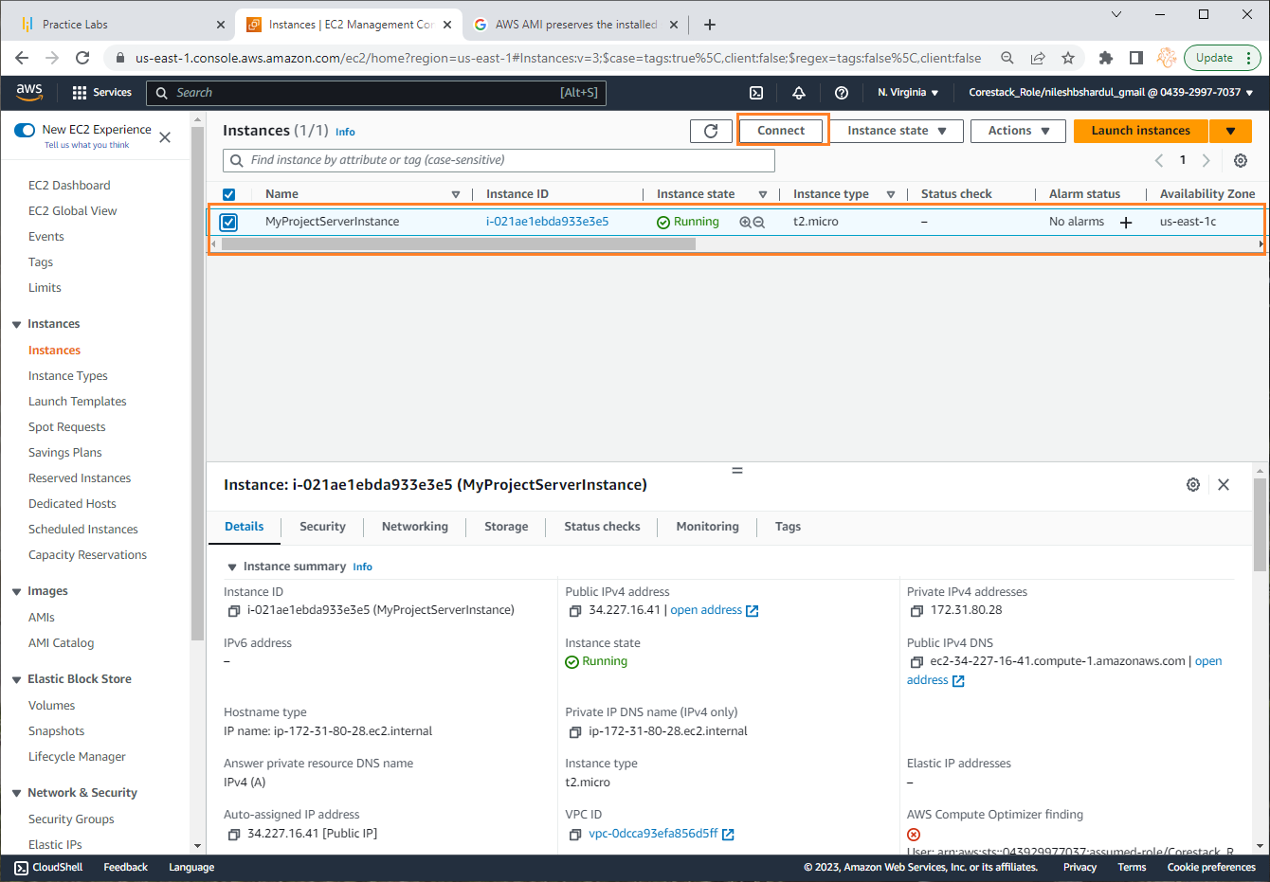
Step 8: Once server is up you can see the instance entry in the EC2 instances list. Now click on Connect button on the top

Slide 26
Create Custom Metric and verify data can be published to CloudWatch from EC2
Note: All configuration selected as per free tier available

Slide 27
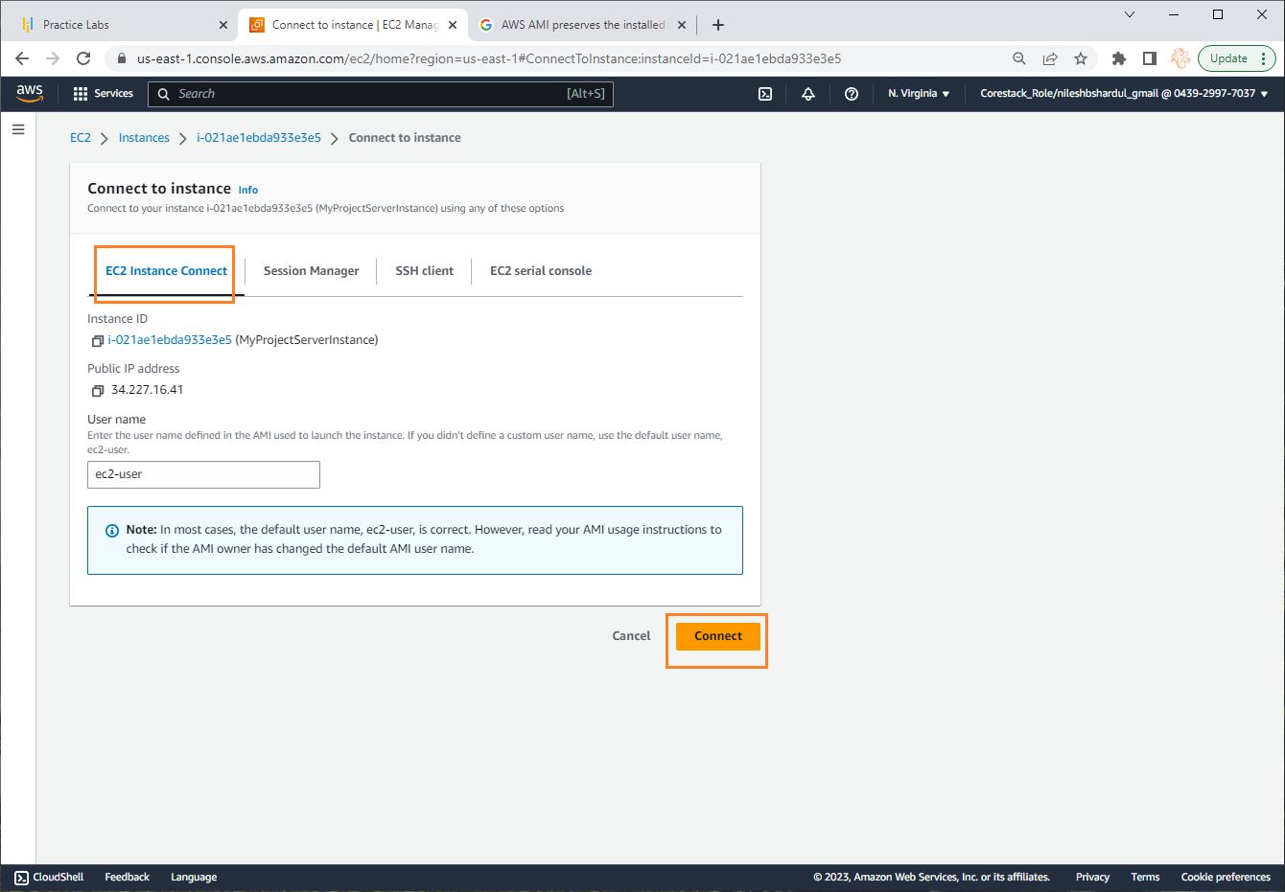
Step 1: Select EC2 Instance Connect tab and click on Connect button

Slide 28
Step 2: Once connected, run command vi postCustomMetric.py to create python file as shown below. This file uses client.put_metric_data() function to push custom metric data to CouldWatch. Please note here you can add your logic to get number of users logged in to your web application and assign it to countOfUsersLoggedIn variable in the program. In the program, I have assigned random number between 0 to 50 to countOfUsersLoggedIn for the purpose of testing Auto-Scaling
import boto3
import random
import requests
import socket
client = boto3.client('cloudwatch', region_name = 'us-east-1')
#Add your custom logic here to get number of users logged in
countOfUsersLoggedIn = float(random.randint(1,50))
print(countOfUsersLoggedIn)
hostname = socket.gethostname()
print(socket.gethostname())
response = client.put_metric_data(
Namespace='MyProjectCustomMetrics',
MetricData=[
{
'MetricName': 'NoOfUsersLoggedIn',
'Dimensions': [
{
'Name': 'Instance Name',
'Value': hostname
},
],
'Value': countOfUsersLoggedIn,
'Unit': 'None'
},
]
)

Slide 29
Step 3: install python, pip and boto3 libraries of python using following commands
#become a root
$ sudo su
#install python
$ yum install python –y
#download required python scripts
$ wget https://bootstrap.pypa.io/get-pip.py
#install required softwares
$ python get-pip.py
$ pip install boto3
#check boto3 version
$ pip show boto3

Slide 30
Step 4: Execute the below commands to install apache2 and create a web page.
#become a root
$ sudo su
#get the list of softwares
$ apt-get update
#install the apache2 webserver
$ apt-get install apache2
# start apache2
$ service apache2 start
#move to the default html folder
$ cd /var/www/html
#delete the existing html folder
$ rm index.html
#create a new index.html
$ Echo “ Welcome to my Web Application” index.html

Slide 31
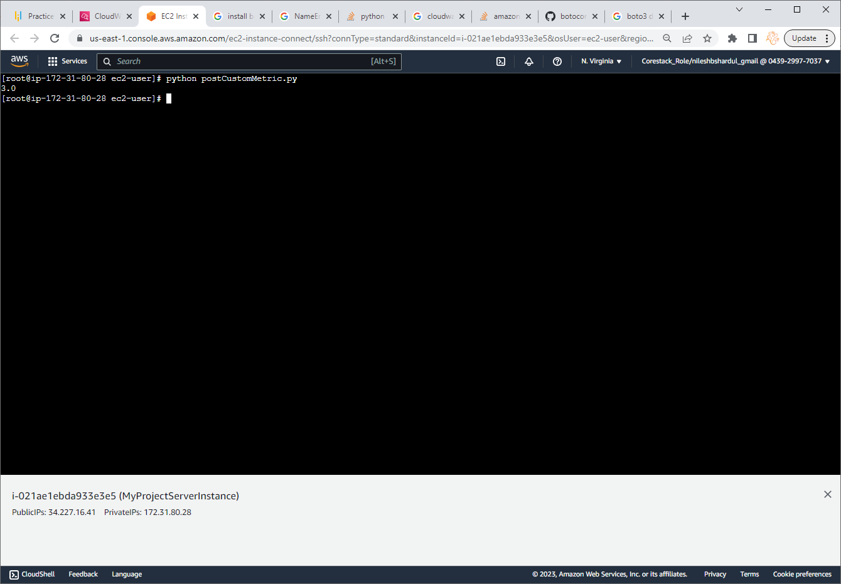
Step 5: Test program by running following command

Slide 32
Step 6: Install crontab by using below command. These are commands for ‘fedora’ version which is installed on EC2 instance Note: The command to check OS version is cat /etc/os-release
#To determine if the package is already present or not
$ rpm -q cronie
#To install crontab
$ sudo dnf install cronie
#Check status of cron service if it is active or not
$ systemctl status crond.service
#Start cron service
$ sudo systemctl start crond.service

Slide 33
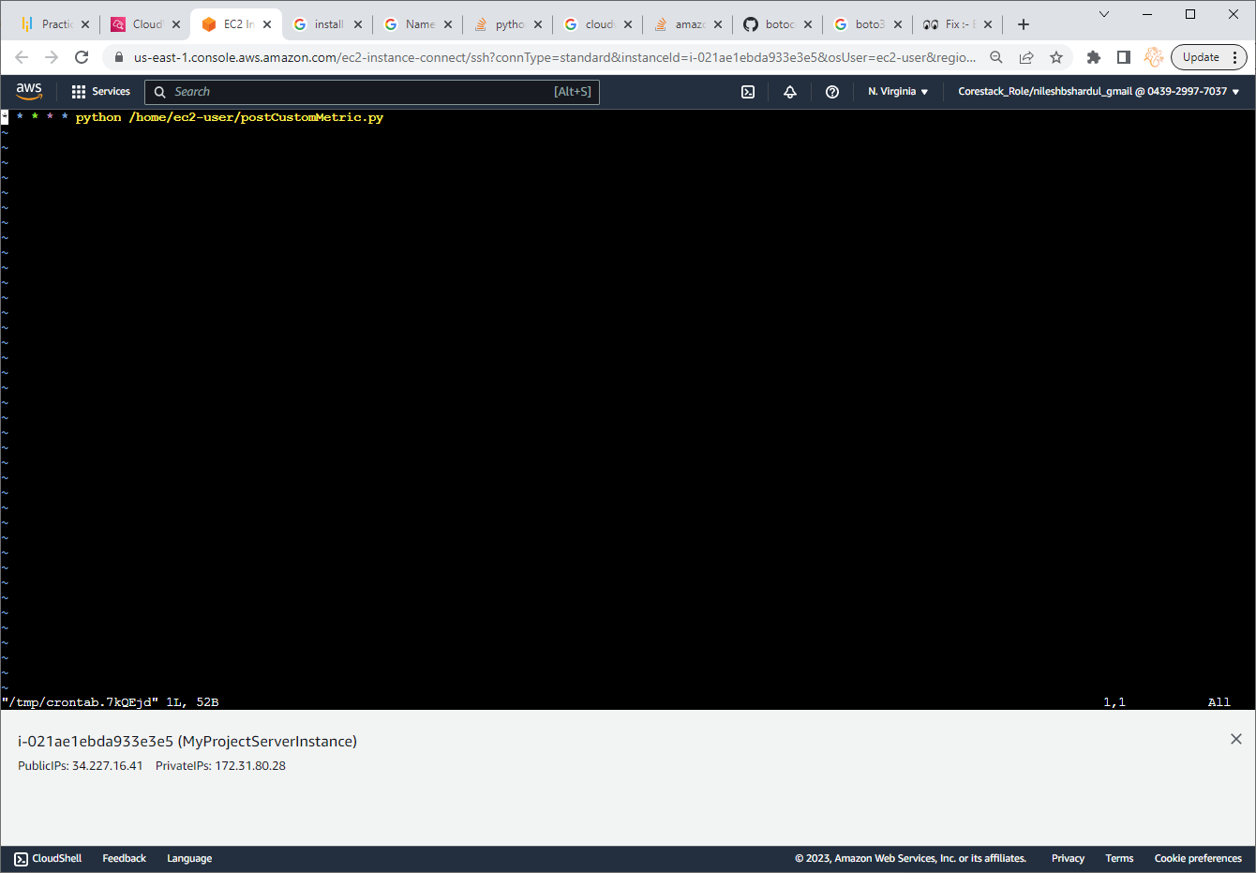
Step 6: Enter contab –e command and add below entry in the file * * * * * python /home/ec2-user/postCustomMetric.py

Slide 34
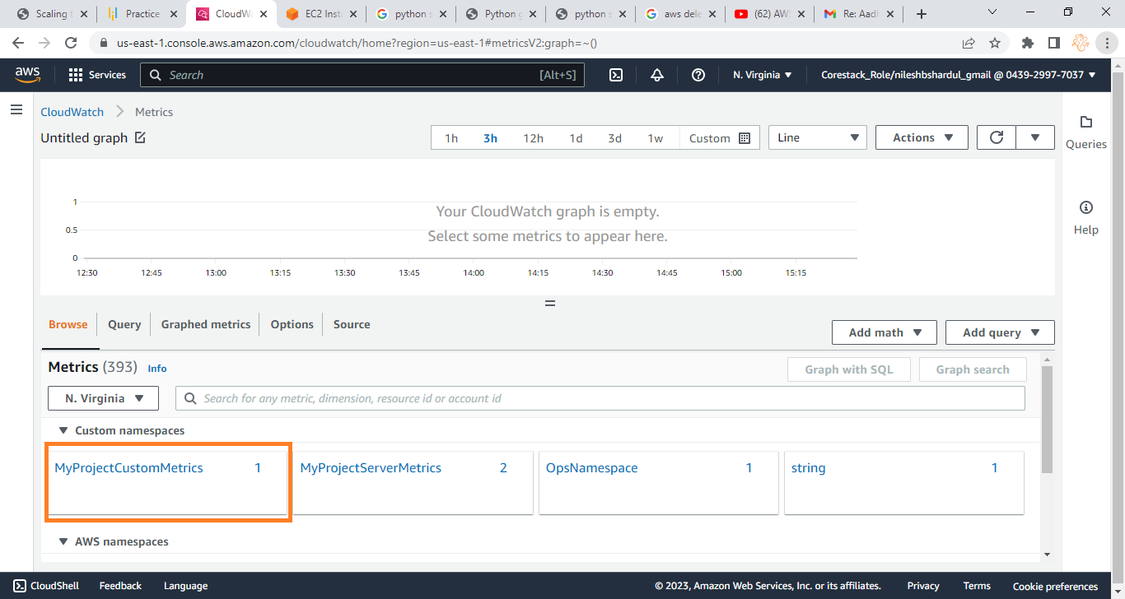
Step 7: Go to CloudWatch service and check All Metrics from the left menu. You will find the custom metric namespace MyProjectCustomMertics under Custom namespaces. Click on MyProjectCustomMertics

Slide 35
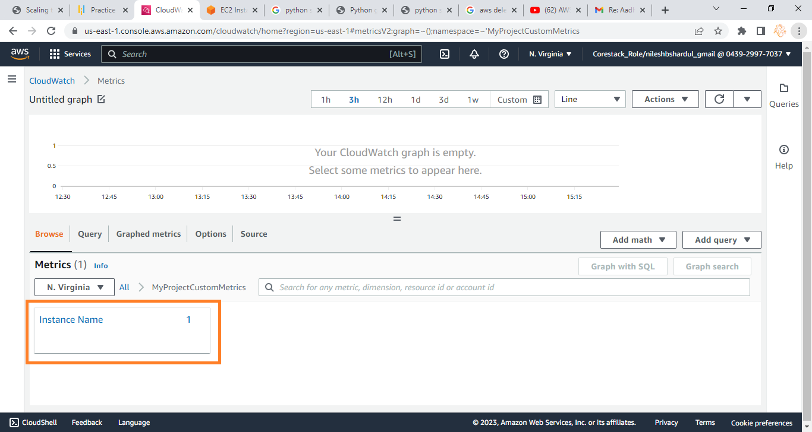
Step 8: Click on dimention Instance Name as shown below

Slide 36
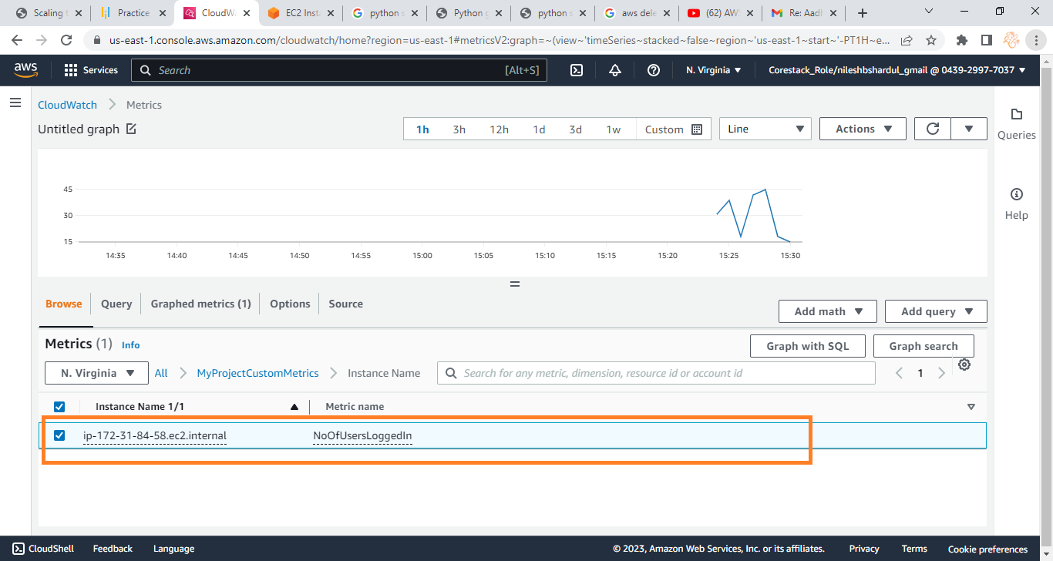
Step 9: IP address of instance will be shown as per the python program we scheduled

Slide 37
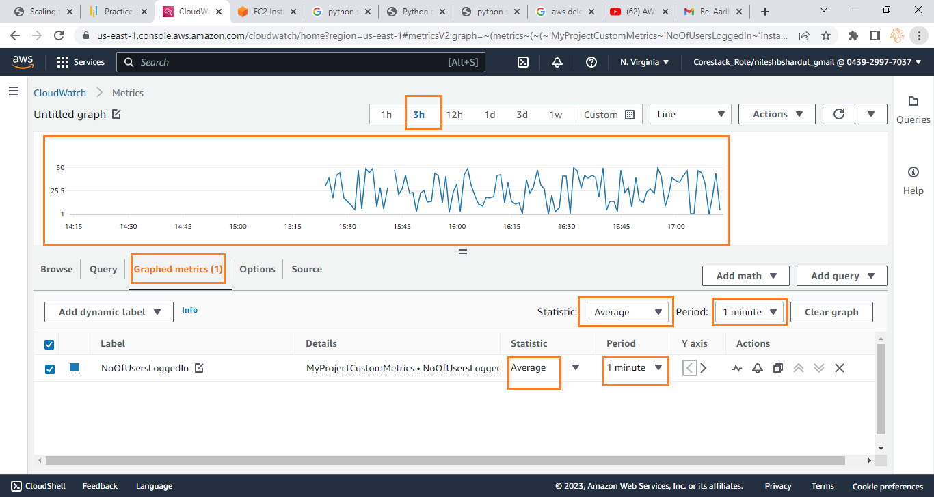
Step 10: Click on Graphed metrics tab as shown below and select on Label NoOfUsersLoggedIn (the data we published using python program) for the EC2 instance. Below screenshot shows data for 3h duration (selected on top), 1 minute period and on Average statistic

Slide 38
Create an Image of the EC2 instance (AMI)
Note: All configuration selected as per free tier available

Slide 39
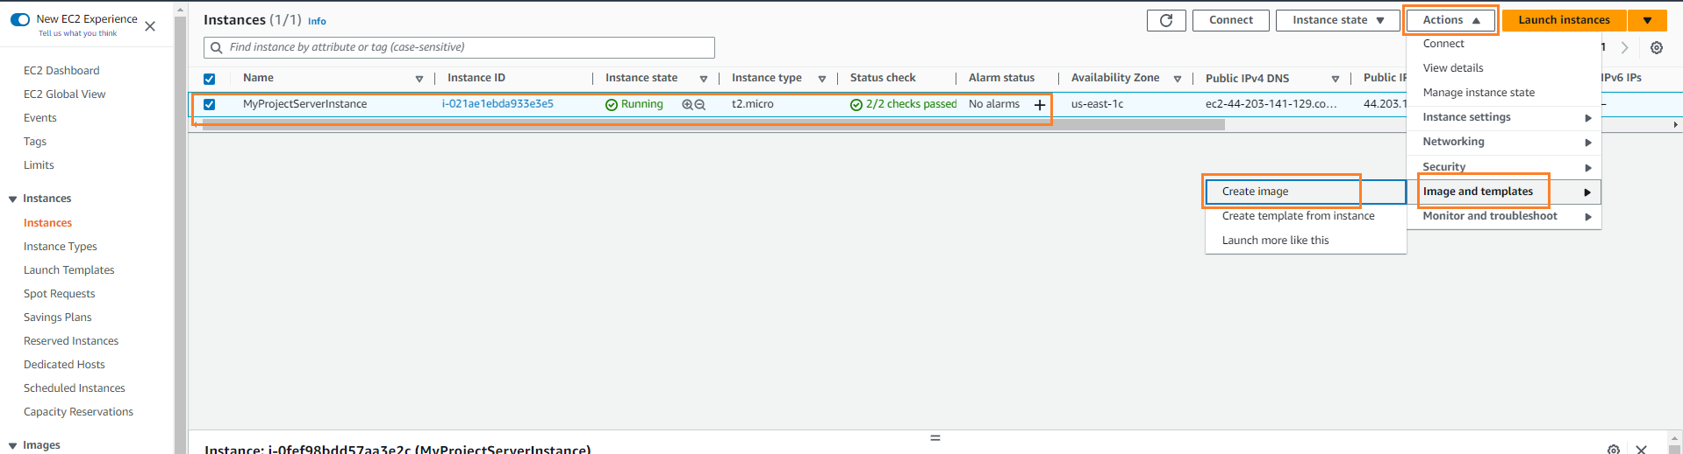
Step 1: To create an image first go to EC2 > instances. Click on Actions > Image and templates > create image

Slide 40
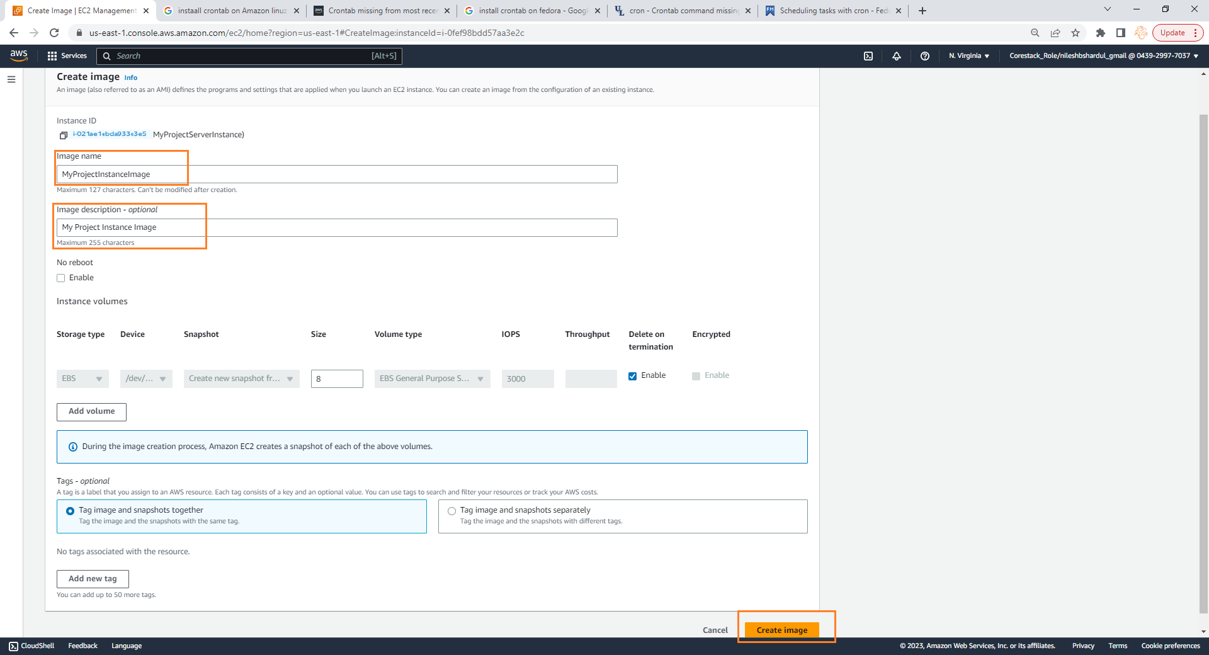
Step 2: Give Image name e.g. MyProjectInstanceImage, Description, keep other default settings and click on Create Image

Slide 41
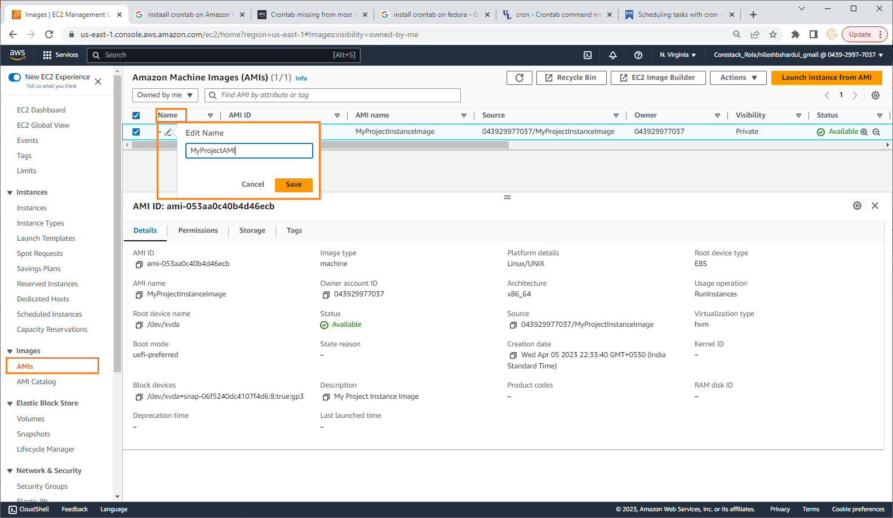
Step 3: Click on Images > AMI on the left menu under EC2, select the image created from the list on the right hand side, you can see the image details below

Slide 42
Create Launch Template
Note: All configuration selected as per free tier available

Slide 43
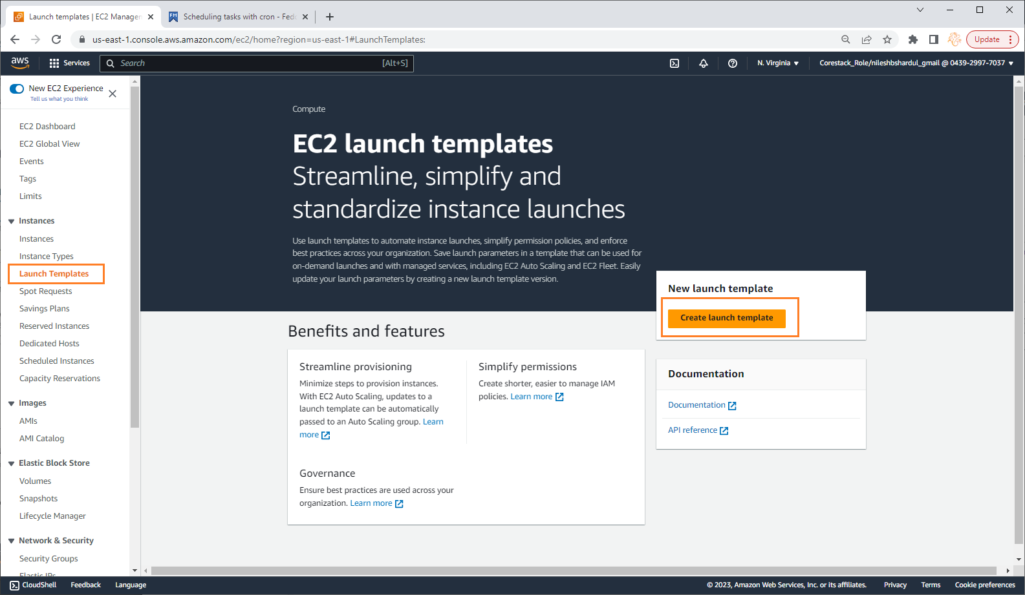
Step 1: Go to EC2 service and then Launch Template from left menu. Click on Create Launch Template button

Slide 44
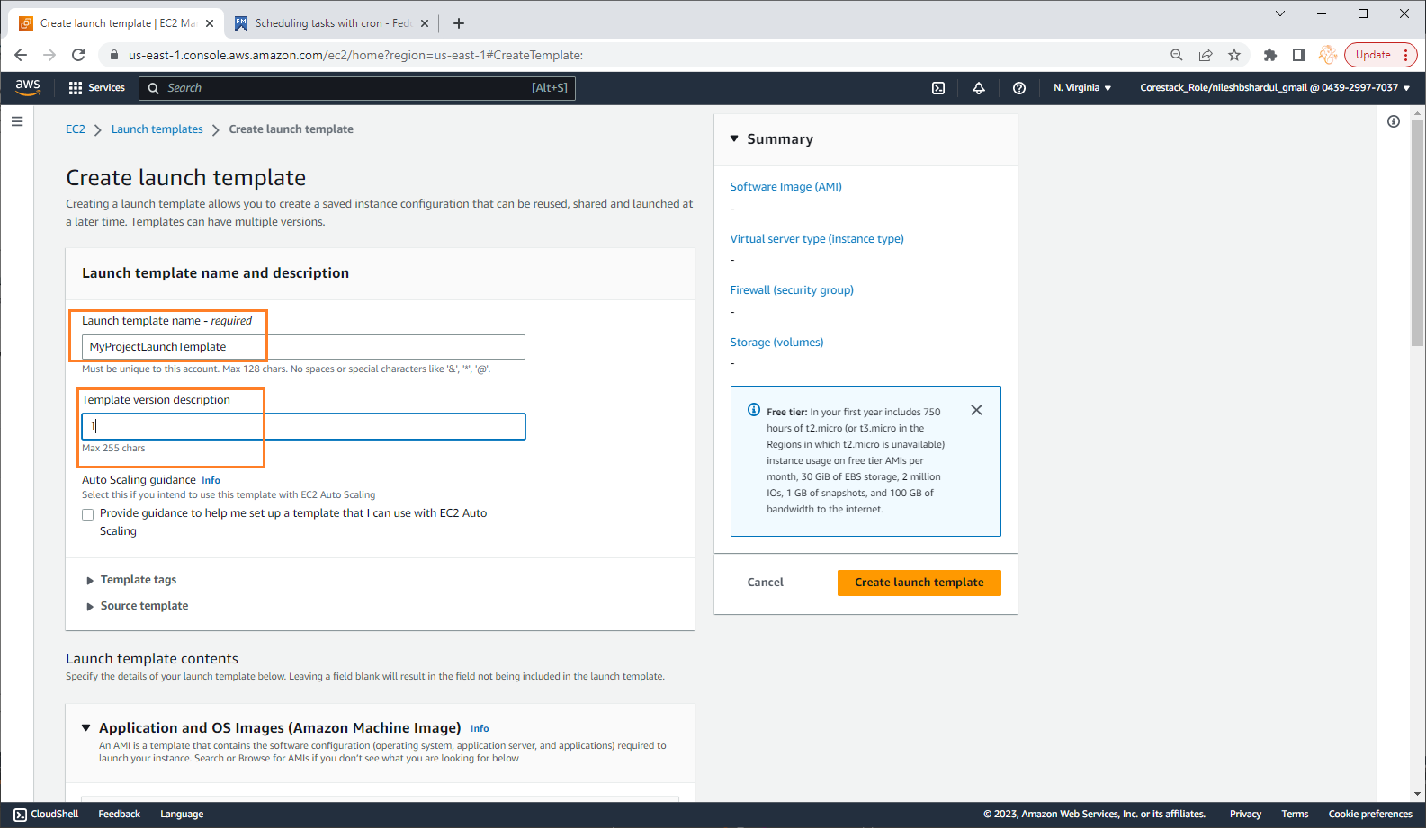
Step 2: Give template name e.g. MyProjectLaunchTemplate and Template version description as 1 (first version)

Slide 45
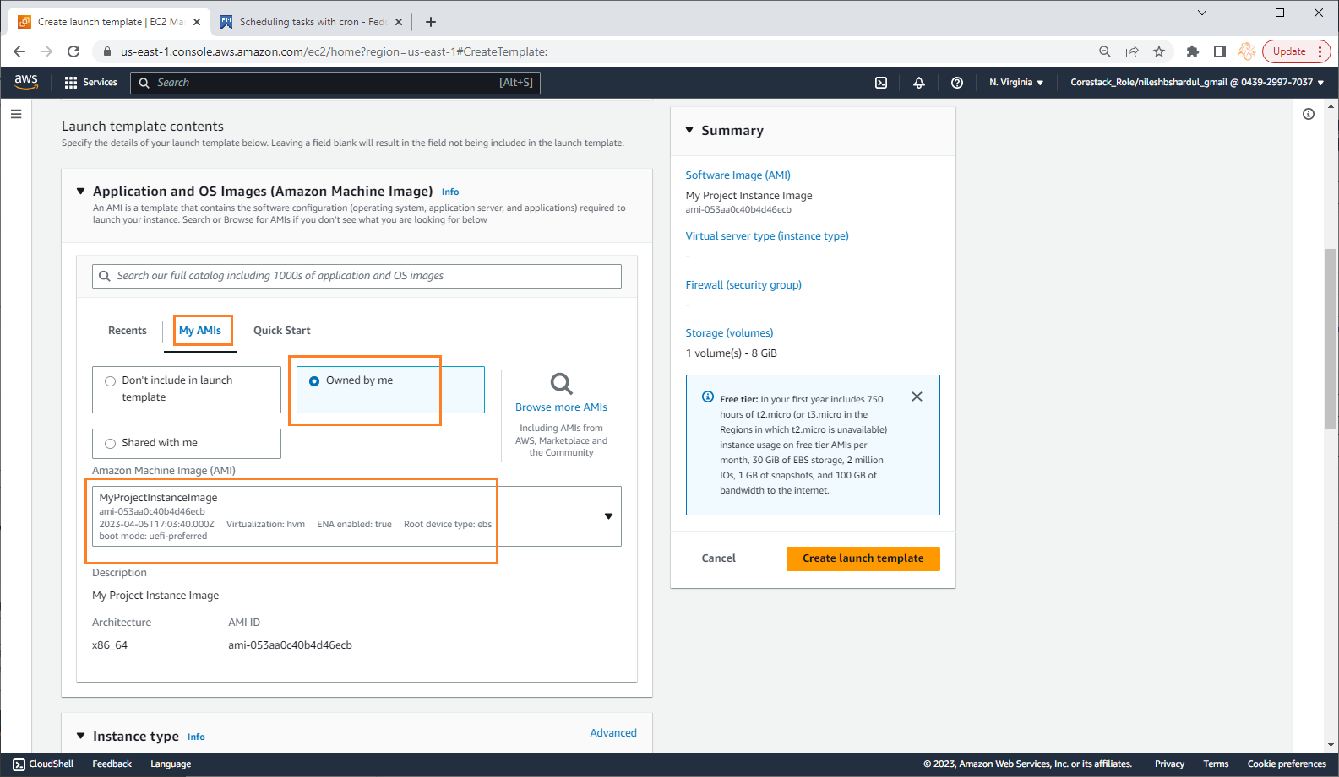
Step 3: Go to My AMI tab, select Owned by me option and the AMI created before e.g. ‘MyProjectInstanceImage’

Slide 46
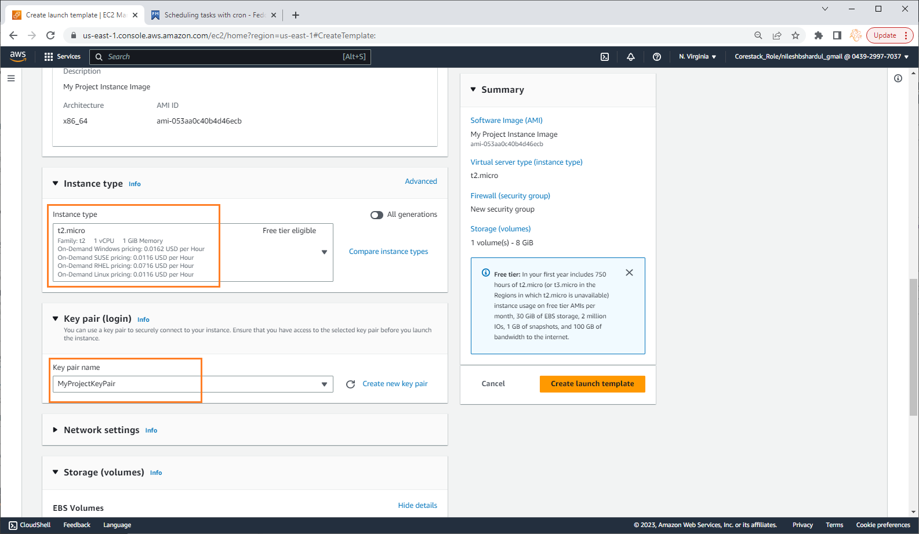
Step 4: Select instance type as t2.micro and the provide key pair created before MyProjectKeyPair

Slide 47
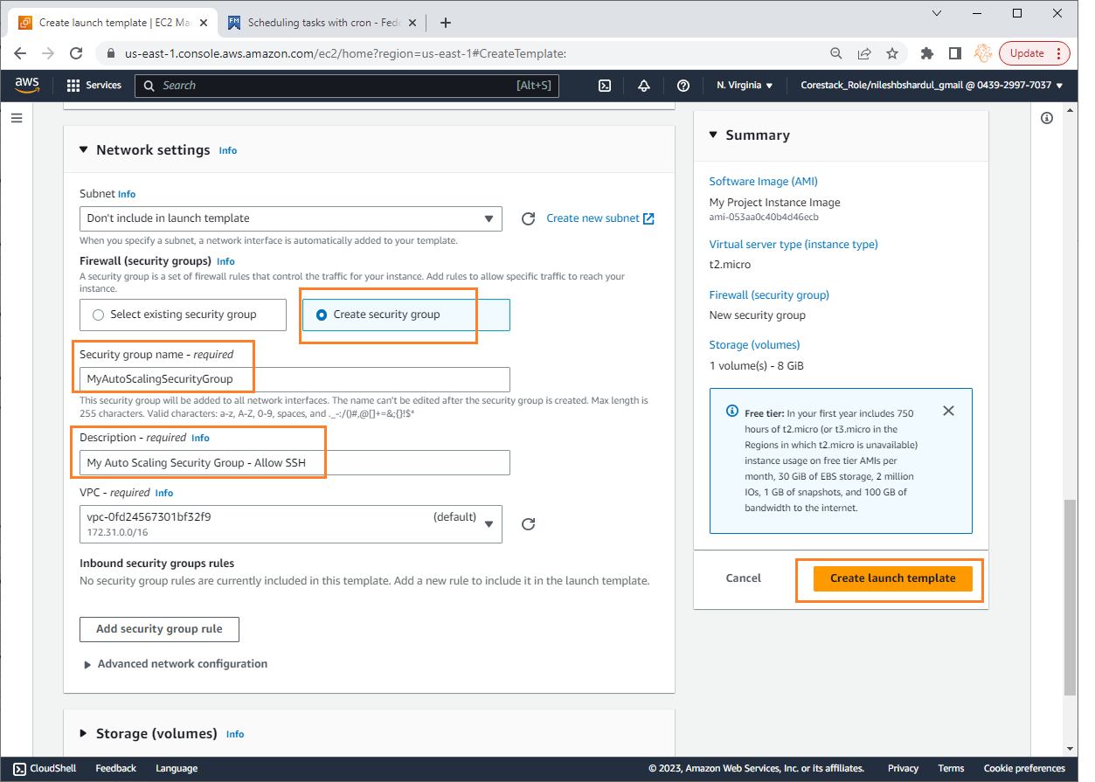
Step 5: Select existing security group which will allow HTTP/80 and SSH/22 traffic inbound. If not exists, create a new one. Select default VPC and click on Create launch template button

Slide 48
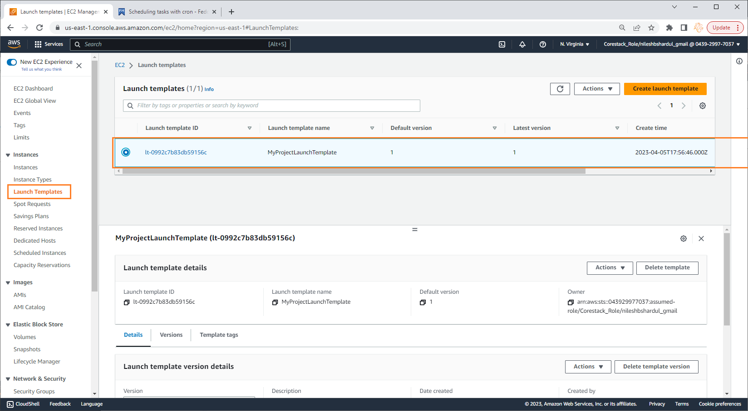
Step 6: New launch template can be seen by selecting Launch template in EC2 service from left menu as shown below

Slide 49
Create Auto Scaling Group
Note: All configuration selected as per free tier available

Slide 50
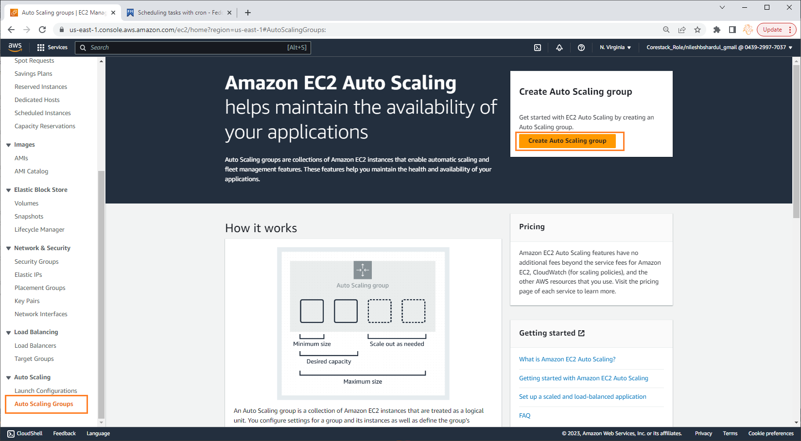
Step 1: Go to EC2 service and select Auto Scaling Groups from left menu as shown below

Slide 51
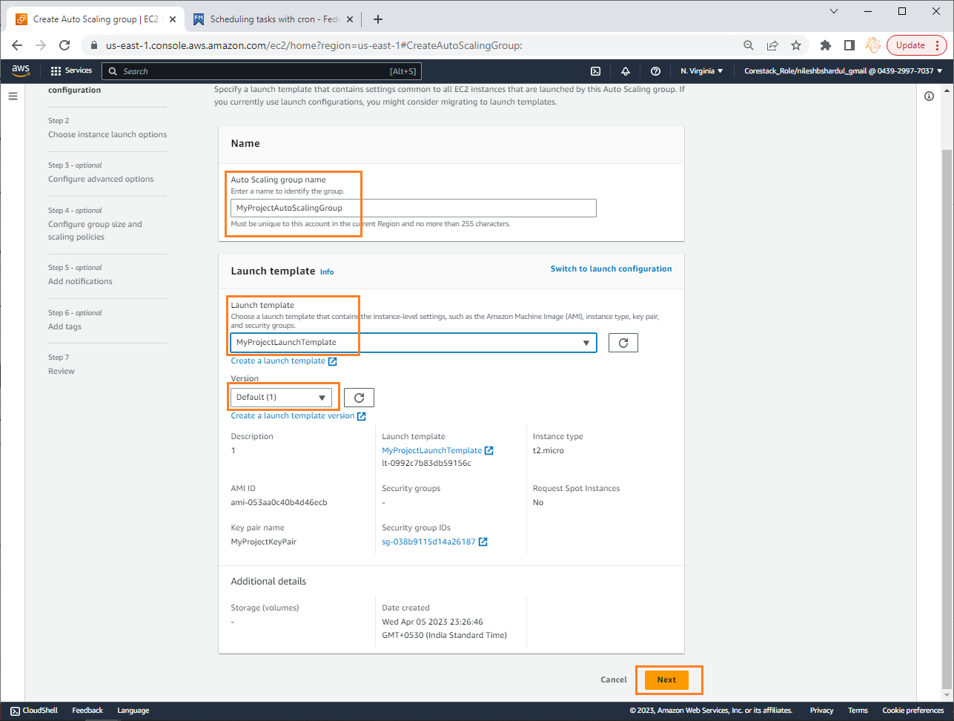
Step 2: Enter Auto scaling group name e.g. MyProjectAutoScalingGroup and select the Launch template e.g. MyProjectLaunchTemplate with its version as shown below

Slide 52
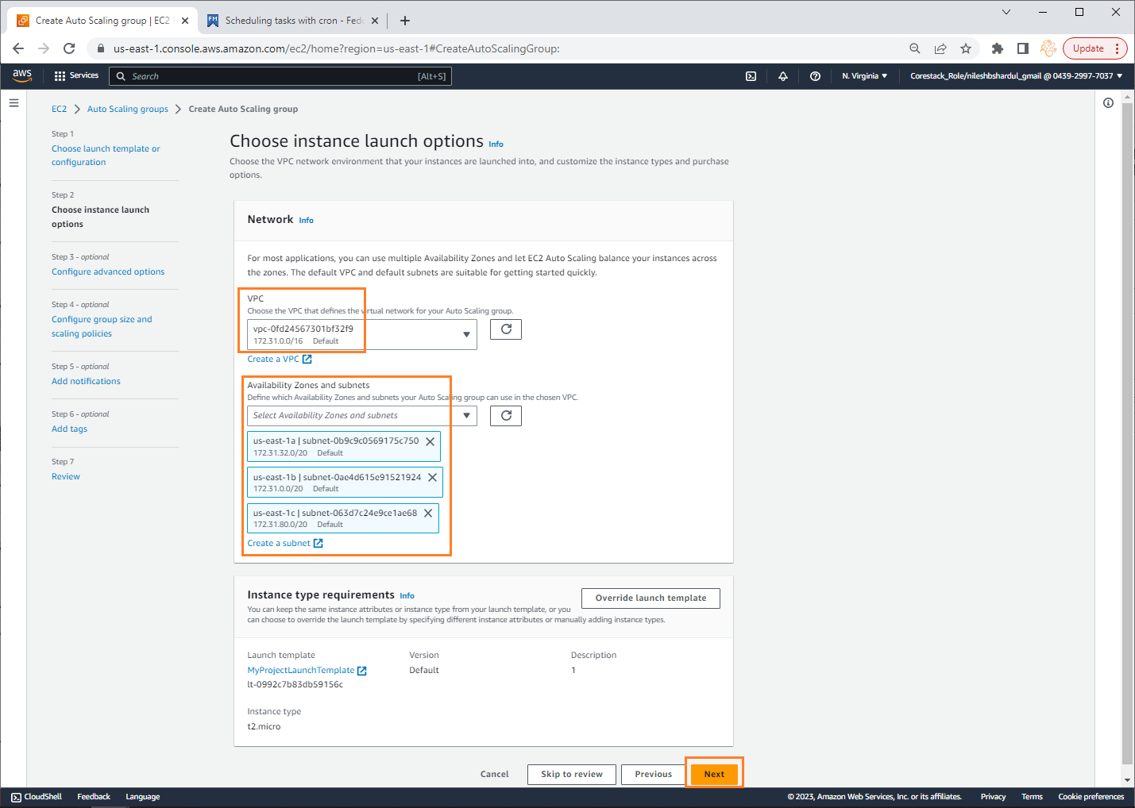
Step 3: Select the VPC and subnets for where Auto Scaling Group can launch EC2 instances. At least one subnet should be selected but it is good practice to select more than one subnet. Click on Next button

Slide 53
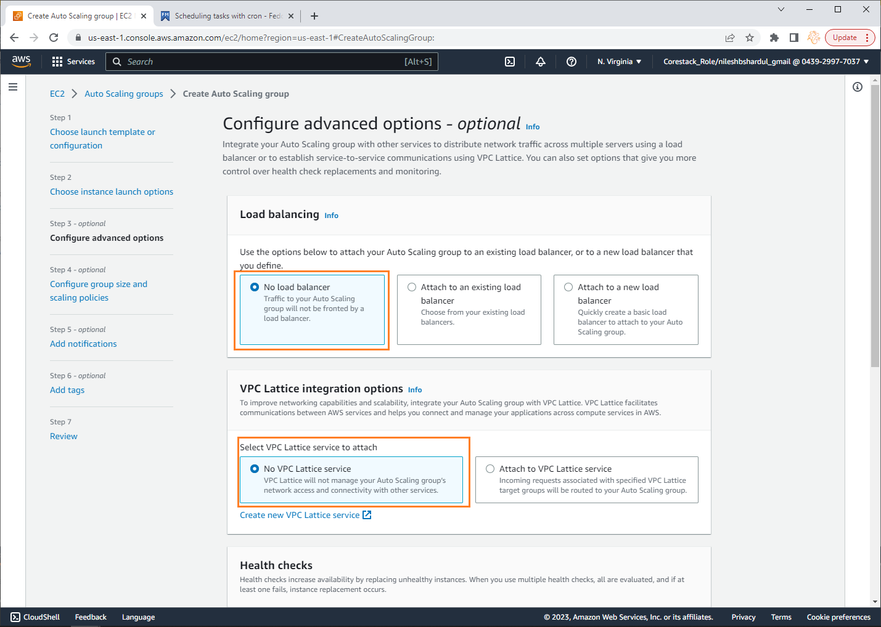
Step 4: Select No Load Balancer option and No VPC Lattice service

Slide 54
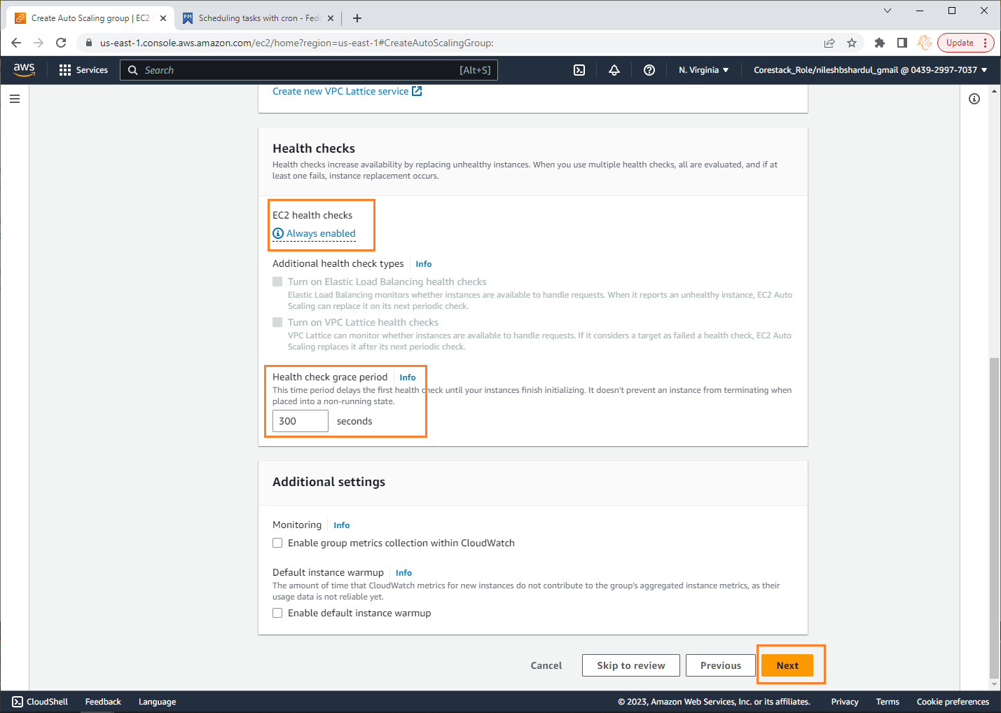
Step 5: Keep EC2 Health Checks always enabled and Health check grace period to 300 seconds (wait time to initialize and run the instance before health check). Click on Next button

Slide 55
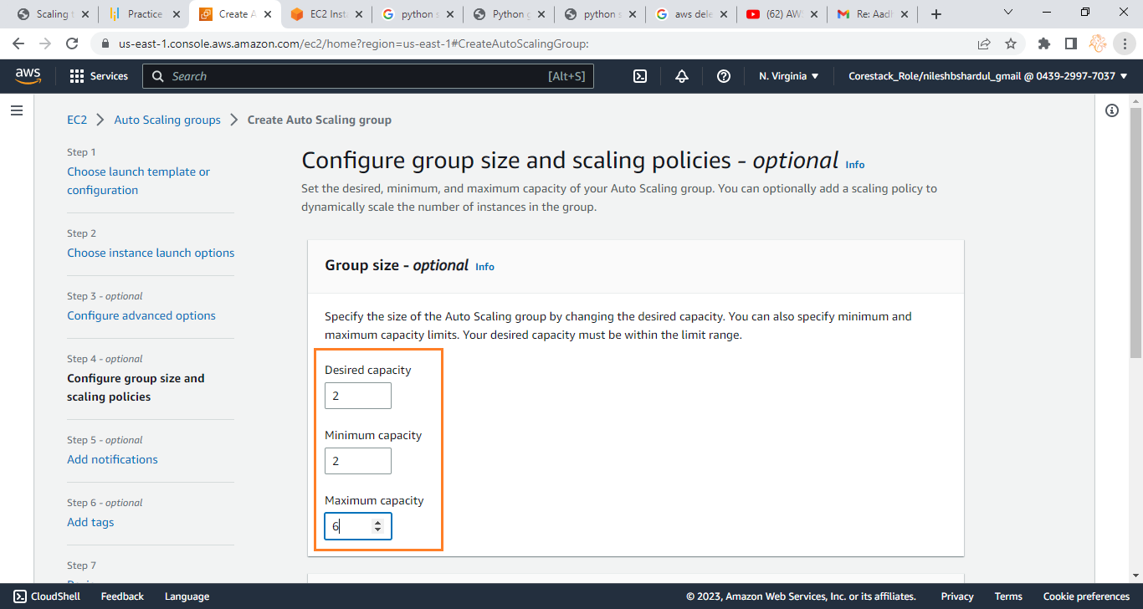
Step 6: Select Desired capacity , Minimum capacity and Maximum capacity of EC2 instances as per your project requirement

Slide 56
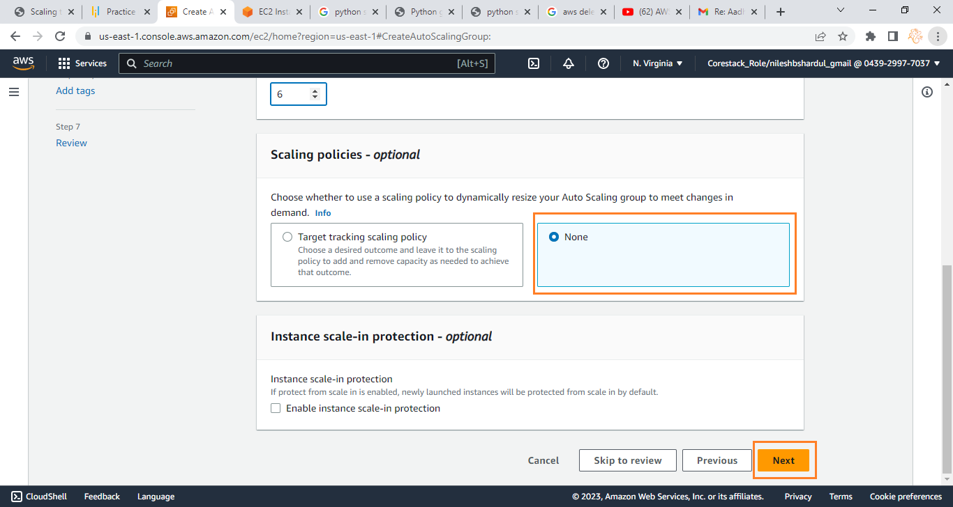
Step 7: Select None for Scaling policies and click on Next button

Slide 57
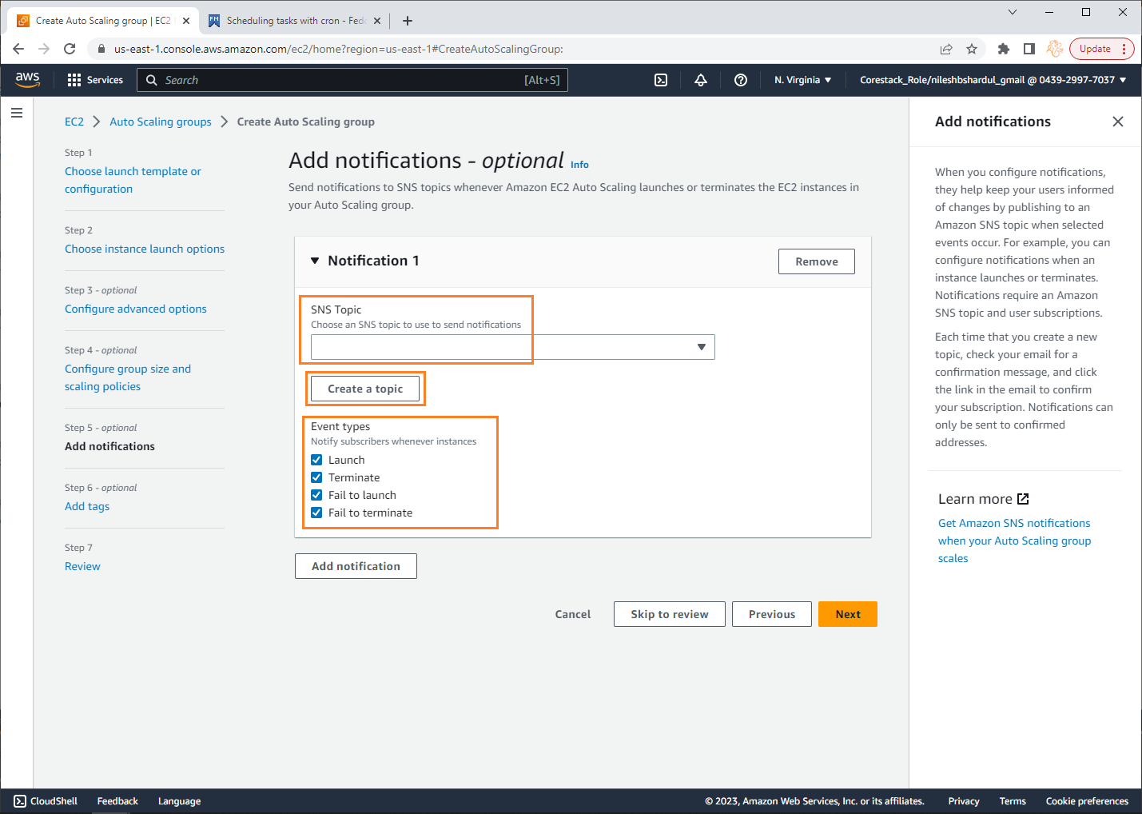
Step 8: You can add notifications by selecting the SNS topic to sent email messages for the four event types as shown below if required. If SNS topic is not available you can create new.

Slide 58
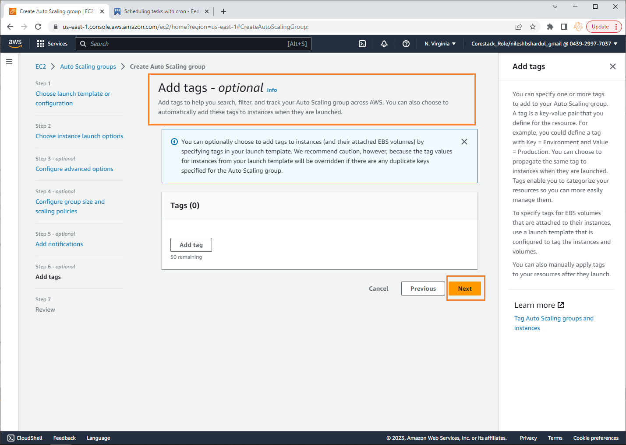
Step 9: Add tags if required and click on Next button after this step.

Slide 59
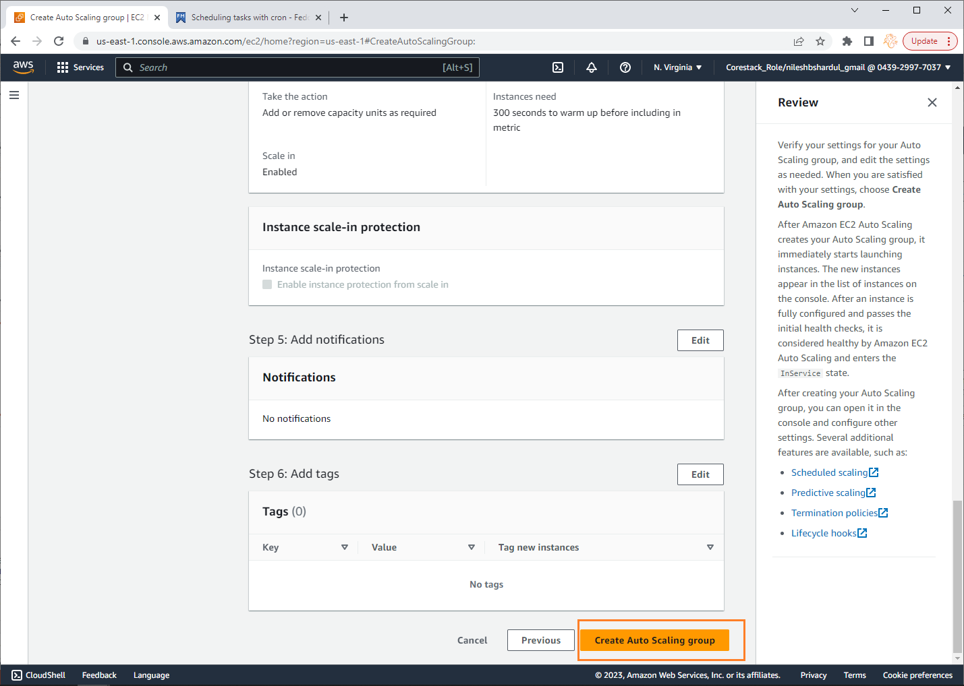
Step 10: Click on Create Auto Scaling group button

Slide 60
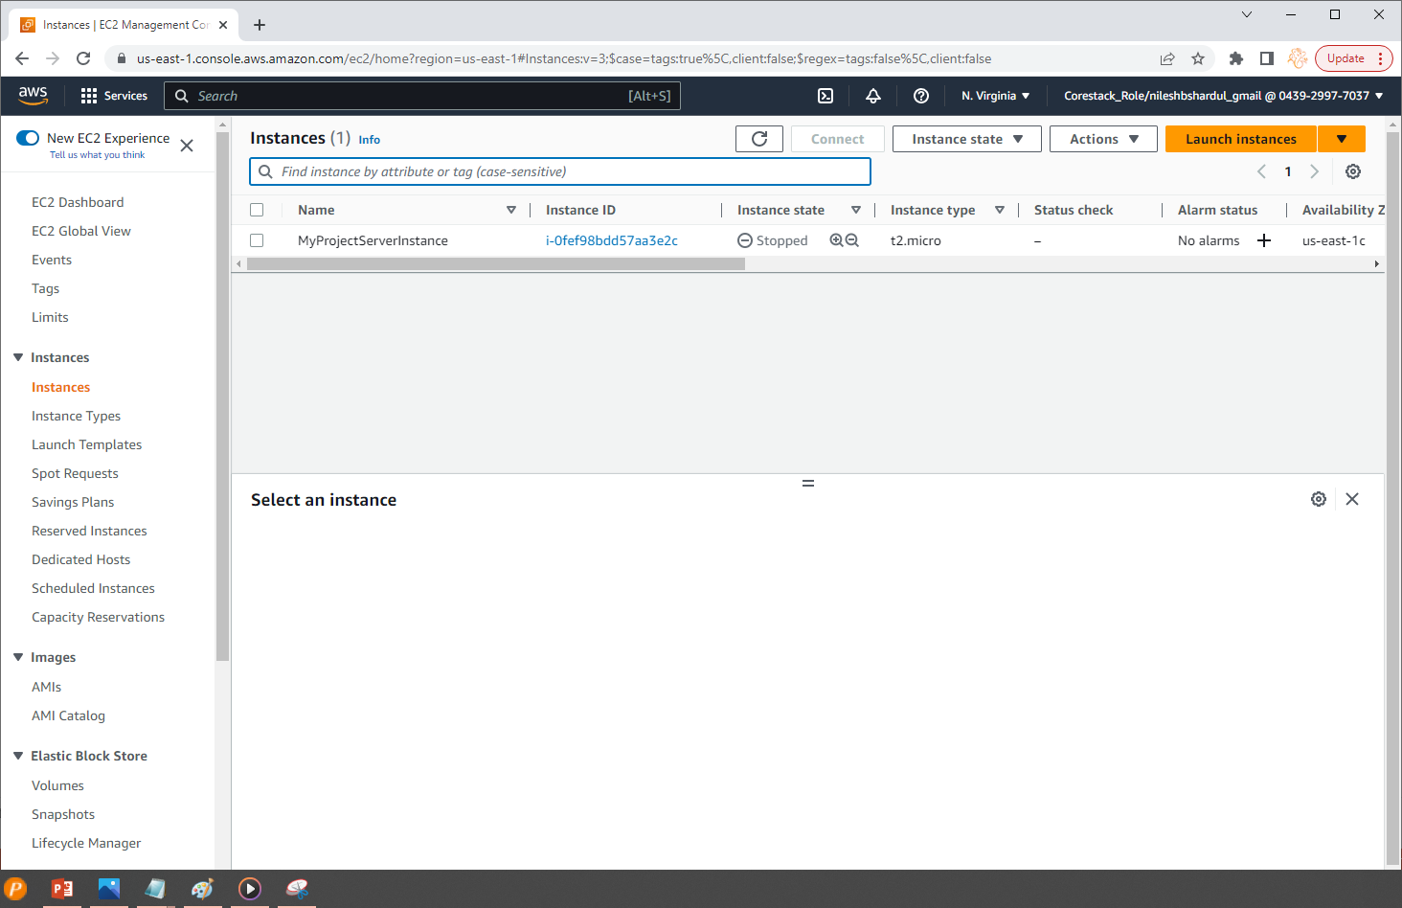
Step 11: This screenshot is taken before clicking on Create Auto Scaling group. You can see only one EC2 instance which is in stopped state

Slide 61
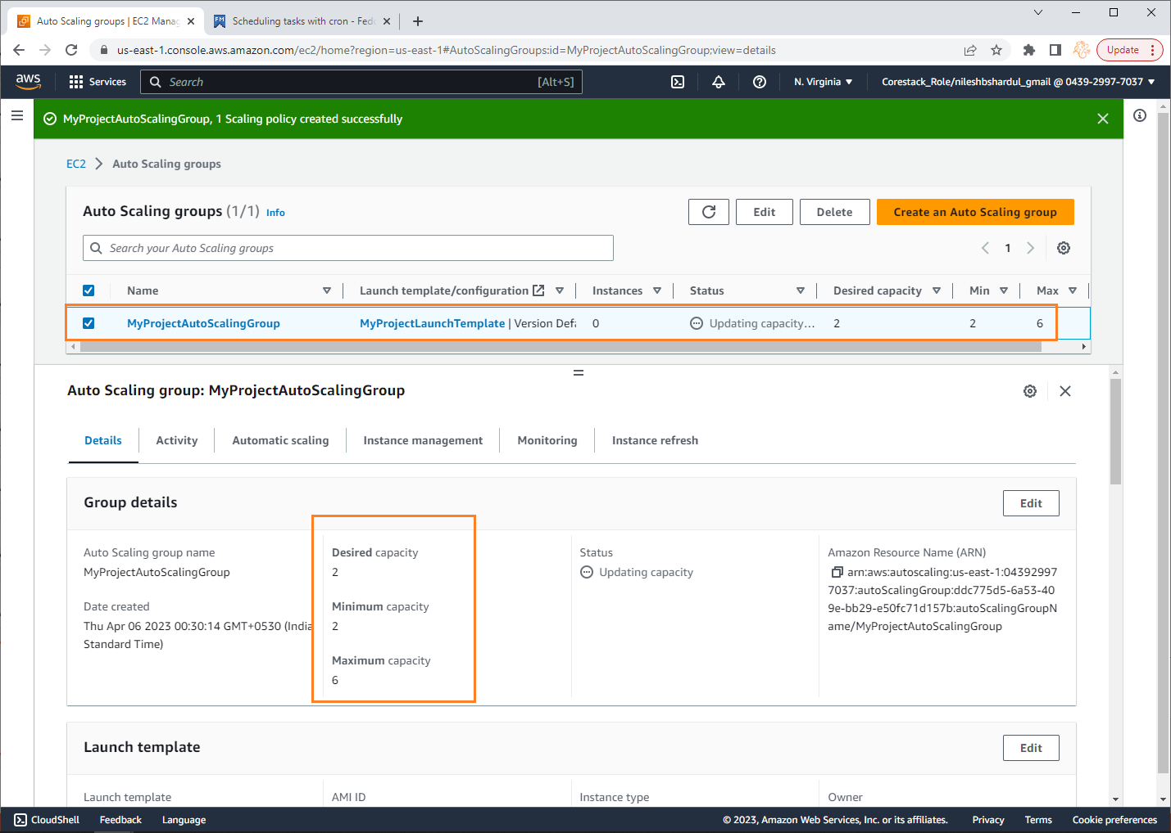
Step 12: Auto Scaling group created after clicking on Create Auto Scaling group button

Slide 62
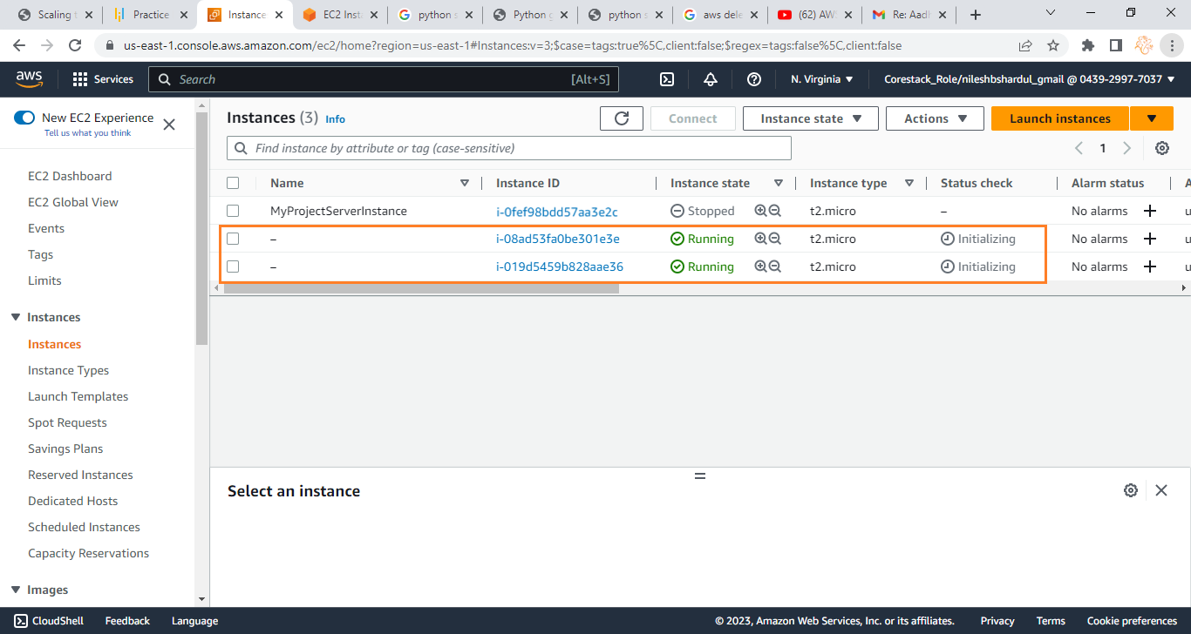
Step 13: Also After you click on Create Auto Scaling group button you can see two new EC2 instances started running immediately (as per Desired capacity mentioned before in Auto Scaling Group)

Slide 63

Step 14: You can check the metrics in CloudWatch for both the new instances as shown below

Slide 64
Create CloudWatch Alarm and test
Auto Scaling
Note: All configuration selected as per free tier available

Slide 65

Step 14: Now create CloudWatch alarm for creating scaling policy. Go to CloudWatch Service then In alarm from left menu. Click on Create alarm button

Slide 66

Step 2: Click on Select metric

Slide 67

Step 3: Select custom metric namespace created before MyProjectCustomMetrics. Click on Instance Name (the Dimension as mentioned in custom metric)

Slide 68

Step 4: You can see both new instances listed. Select the instance on which you would like to monitor no of users logged in and apply scaling policy. Click on Select metric button IMPORTANT PLEASE NOTE : This metric can be a Database value which records no of users logged in to your application or any other source which provide you this logged in users’ count. But for my project, I have added custom metric on the instance level which is monitoring for no of user logged in. You can decide this logic as per your project need.

Slide 69

Step 5: The details of selected metric are shown in the below screenshot

Slide 70

Step 6: Scroll down and select Conditions as shown below e.g. for this project, I have selected below conditions to trigger alram: Threshold type = Static If NoOfUsersLoggedIn > 35 Click on Next button after selecting Conditions

Slide 71

Step 7: You can notify the user by email if required by selecting SNS topic or else click on Remove button to proceed further

Slide 72

Step 8: Click on Next button to proceed

Slide 73

Step 9: Give name to the new alarm e.g. MyProjectAutoScaleAlarm and click on Next button

Slide 74

Step 10: Finally click on Create alarm button

Slide 75

Step 11: You can see the new alarm created in All Alarms from left menu in CloudWatch service as shown in the below screenshot.

Slide 76

Step 12: Now open the auto scaling group again which we have created before -MyProjectAutoScalingGroup. Open Automatic scaling tab and click on Create dynamic scaling policy button

Slide 77

Step 13: Select Policy type as Simple scaling, write Scaling policy name created before MyProjectSimpleScalingPolicy, select CloudWatch alarm created before MyProjectAutoScaleAlarm. Select Add in Take the action and select no of instances you want to add e.g. 1 capacity units (1 instance). Keep some waiting time e.g. 300 seconds before allowing another scaling activity. Finally Click on Create button to create the new policy.

Slide 78

Step 14: You can see the new policy name MyProjectSimpleScalingPolicy created in Auto Scaling group MyProjectAutoScalingGroup

Slide 79

Step 15: Go to CloudWatch service All alarms and open the alarm created before MyProjectAutoScaleAlarm. Below screenshot shows the threshold value crossed (>35) after creating the alarm

Slide 80

Step 16: The result of crossing threshold value can be seen in the below screenshot i.e. One more EC2 instance is started

Slide 81

Step 17: After some few more points seen crossing threshold value in the line graph

Slide 82

Step 18: Which results in 3 more new instances started running. You can see max 6 EC2 instances running

Slide 83
Conclusion
As the number of users logged in to the web application increases, the Auto Scaling Group automatically adds an EC2 instance, allowing the load to be balanced across the EC2 instances. Therefore, better response time for the application and better customer satisfaction.

Slide 84
THANK YOU !

